Slide 1
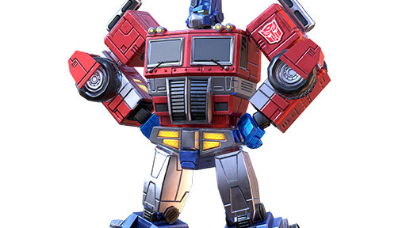
Transformers
“The best idea in A.I.” – Andrej Karpathy

Slide 2










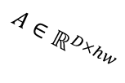







Everything is a set of tokens
${\{x_{i}\}}_{i=1}^{T}⊂ℝ^{D}$, $X∈ℝ^{D×T}$
tokenize
Binary Pair Encoding dictionary (P. Gage 1994)
patchify
[791, 1595, 13043, 14370, 63, 315, 87970, 527, 7437, 315, 11460, 430, 527, 1595, 4806, 291, 63, 439, 814, 1522, 1555, 279, 4009, 13]
$$ℝ^{H×W}$$
flatten
Skip-Gram with Negative Sampling (T. Mikolov, et al. 2013)
Trained together with the transformer (J. Devlin, et al. 2018)
Matroyshka Representation Learning (A. Kusupati, et al. 2022)
$${\left(ℝ^{h×w}\right)}^{9}$$
embed
embed
$$\left\{{\tilde{x}}_{1},…,{\tilde{x}}_{23}\right\}⊂ℝ^{D}$$
$$ℝ^{hw×9}$$
$$A∈ℝ^{D×hw}$$
$$\tilde{X}∈ℝ^{D×23}$$
$${\tilde{X}∈ℝ}^{D×9}$$
(A. Dosovitskiy, et al. 2020)

Slide 3
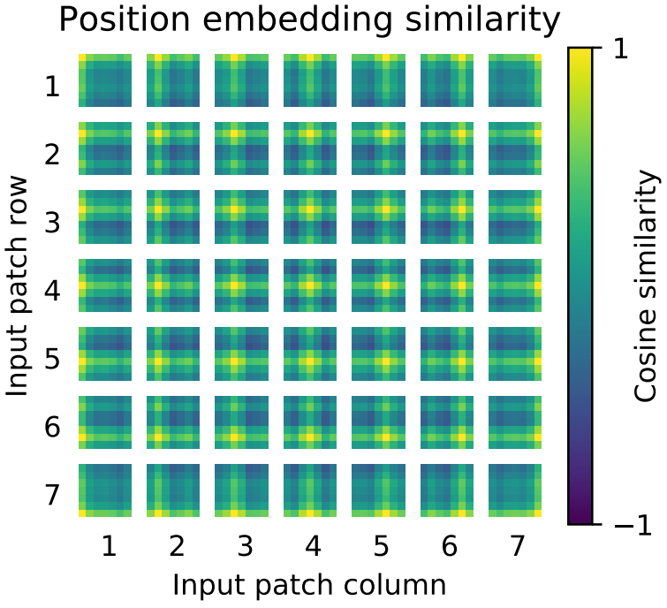
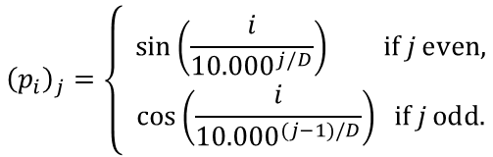

Positional encoding
$$x_{i}={\tilde{x}}_{i}+p_{i}$$
what?
where?
$p_{i}^{T}p_{j}$ is small if tokens i and j are far away and big if they are near
Trigonometric 1D for text
Trained 2D for images
$${\left(p_{i}\right)}_{j}=\left\{\begin{aligned}\sin\left(\frac{i}{{10.000}^{j/D}}\right) \text{if} j \text{even}\text{,} \\ \cos\left(\frac{i}{{10.000}^{(j−1)/D}}\right) \text{if} j \text{odd}\text{.}\end{aligned}\right.$$
Vaswani, Ashish, et al. "Attention is all you need." Advances in neural information processing systems 30 (2017).
Dosovitskiy, Alexey, et al. "An image is worth 16x16 words: Transformers for image recognition at scale." arXiv:2010.11929 (2020).

Slide 4

Conjecture
For any metric space $\left(M,d_{M}\right)$ there exists a continuous $φ:M→L^{2}(Ω)$ for some compact $Ω⊂ℝ^{n}$ so that for all $p,q∈M:d_{M}\left(p,q\right)$ is a monotone decreasing function of ${\left(φ\left(p\right),φ\left(q\right)\right)}_{L^{2}(Ω)}$.

Slide 5
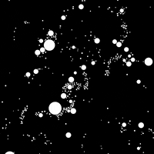










Transformer block
$$x_{1}(t+1)$$
$$x_{2}(t+1)$$
$$x_{3}(t+1)$$
$$…$$
$$x_{T}(t+1)$$
Transformer Block
$$x_{1}(t)$$
$$x_{2}(t)$$
$$x_{3}(t)$$
$$…$$
$$x_{T}(t)$$

Slide 6




Transformer block
$$X(t+1)$$
Add & Norm
$$x_{i}↦\frac{x_{i}+FF(x_{i})}{\left\|x_{i}+FF(x_{i})\right\|}$$
Feed Forward
Add & Norm
$$x_{i}↦\frac{x_{i}+MHA{\left(X(t)\right)}_{i}}{\left\|x_{i}+MHA{\left(X(t)\right)}_{i}\right\|}$$
Multi-Head Attention
$$X(t)$$

Slide 7
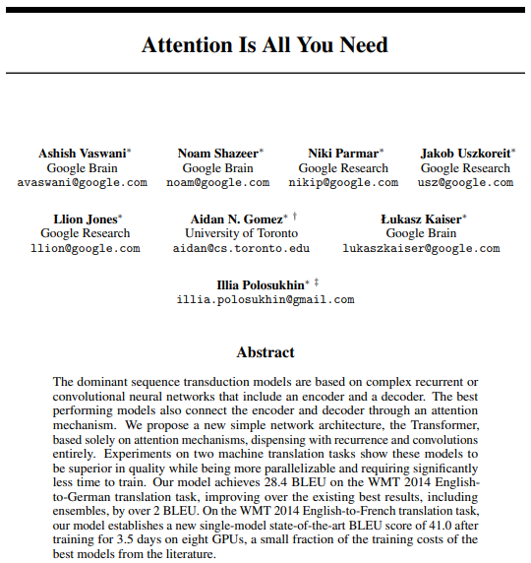


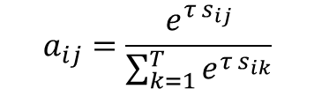
Attention
What conventional NNs train:
Vaswani, Ashish, et al. "Attention is all you need." Advances in neural information processing systems 30 (2017).
$$y=Ax$$
What transformers train in addition:
$$s_{ij}=x_{i}^{T}Bx_{j}∈ℝ \text{for} \text{all} i, j=1,…,T$$
$$a_{ij}=\frac{e^{{τ s}_{ij}}}{\sum_{k=1}^{T}{e^{{τ s}_{ik}}}}$$
$$S=\left[\begin{matrix}−0.5 & 3.1 \\ 2.0 & 2.4\end{matrix}\right] ↦ A=\left[\begin{matrix}0.027 & 0.973 \\ 0.401 & 0.599\end{matrix}\right]$$

Slide 8
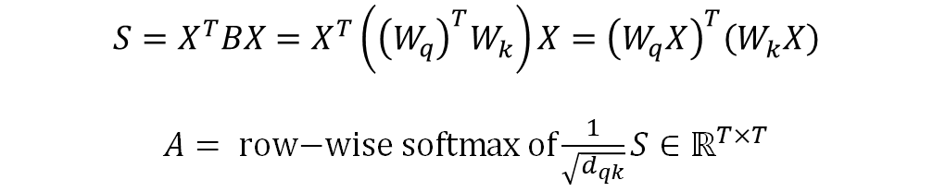

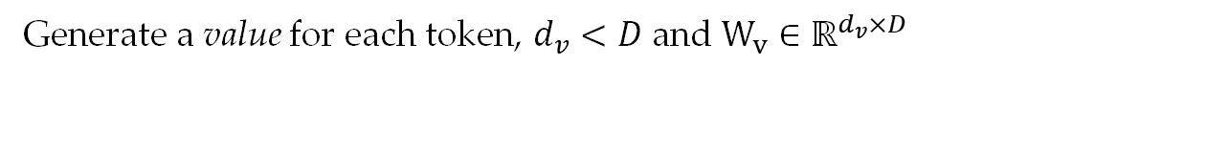
Query, key & value
$D^{2}$ is a lot of parameters: pick $d_{qk}<D$ and $W_{q},W_{k}∈ℝ^{d_{qk}×D}$
$$S=X^{T}BX=X^{T}\left({\left(W_{q}^{ }\right)}^{T}W_{k}^{ }\right)X={\left(W_{q}^{ }X\right)}^{T}\left(W_{k}^{ }X\right)$$
$A= \text{row}\text{−}\text{wise} \text{softmax} \text{of}\frac{1}{\sqrt{d_{qk}}}S∈ℝ^{T×T}$
Generate a value for each token, $d_{v}<D$ and $W_{v}^{ }∈ℝ^{d_{v}×D}$
$$Y=W_{v}^{ }XA∈ℝ^{d_{v}×T}$$
The Y constitutes the output of a single attention head and $W_{q}^{ },W_{k}^{ }$ and $W_{v}^{ }$ are its parameters.

Slide 9




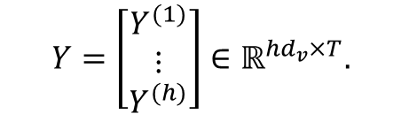
Multi-head attention
Use a set of $h>0$ attention heads to generate a set of outputs $Y^{\left(1\right)},Y^{(2)},…,Y^{\left(h\right)}∈ℝ^{d_{v}×T}$
$$Y=\left[\begin{matrix}Y^{(1)} \\ ⋮ \\ Y^{(h)}\end{matrix}\right]∈ℝ^{hd_{v}×T}.$$
$$X(t+1)$$
Add & Norm
Take a matrix $W_{p}∈ℝ^{D×hd_{v}}$ to project the concatenated outputs of the heads
Feed Forward
$\text{MHA}\left(X\right)=W_{p}Y∈ℝ^{D×T}$.
Add & Norm
Add and normalize token-wise (LayerNorm, RMSNorm):
Multi-Head Attention
$X↦norm(X+\text{MHA}(X))$.
$$X(t)$$

Slide 10
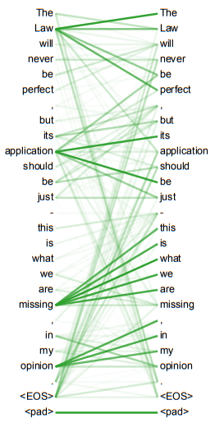
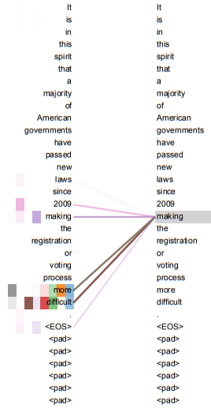
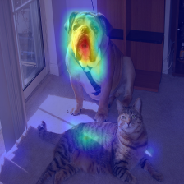
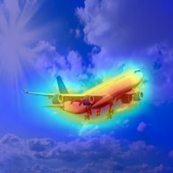
Attention can be intuitive
Vaswani, Ashish, et al. "Attention is all you need." Advances in neural information processing systems 30 (2017).
jacobgil.github.io/deeplearning/vision-transformer-explainability

Slide 11
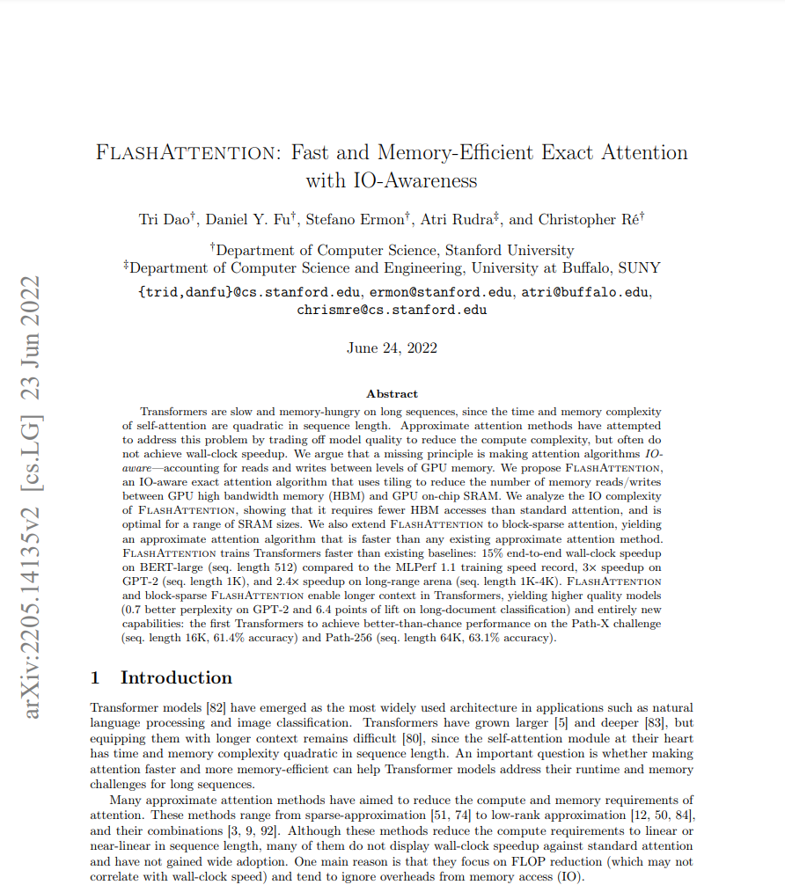
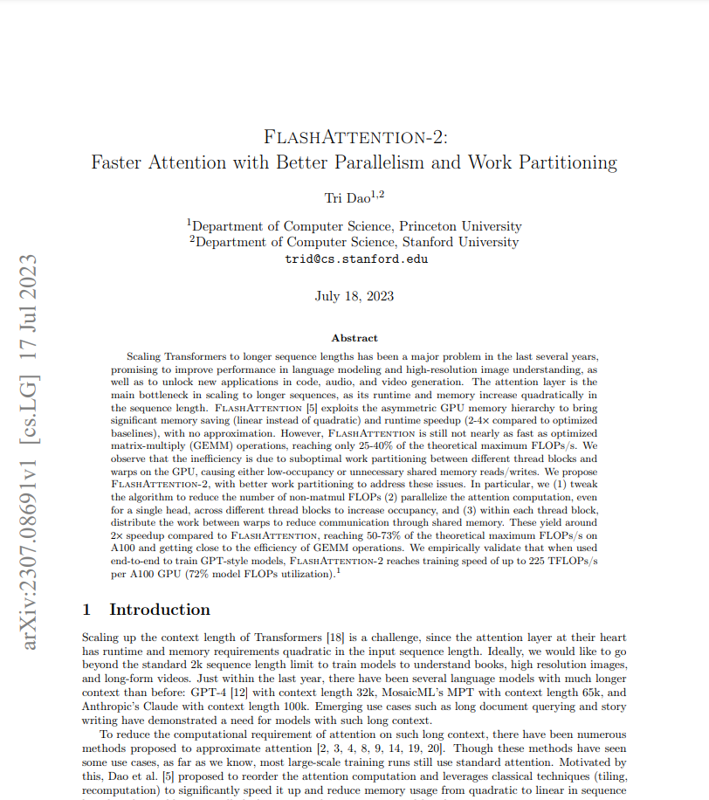
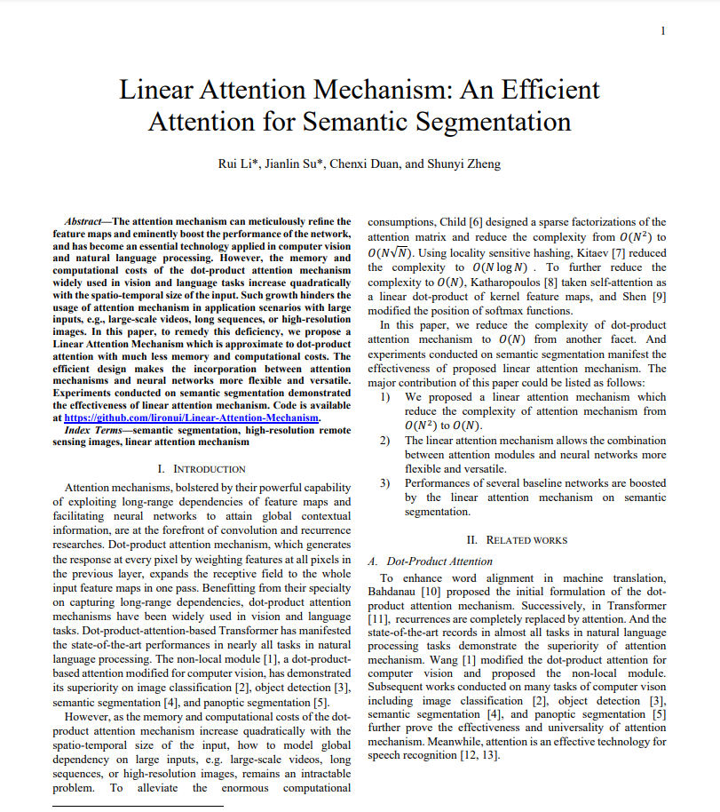
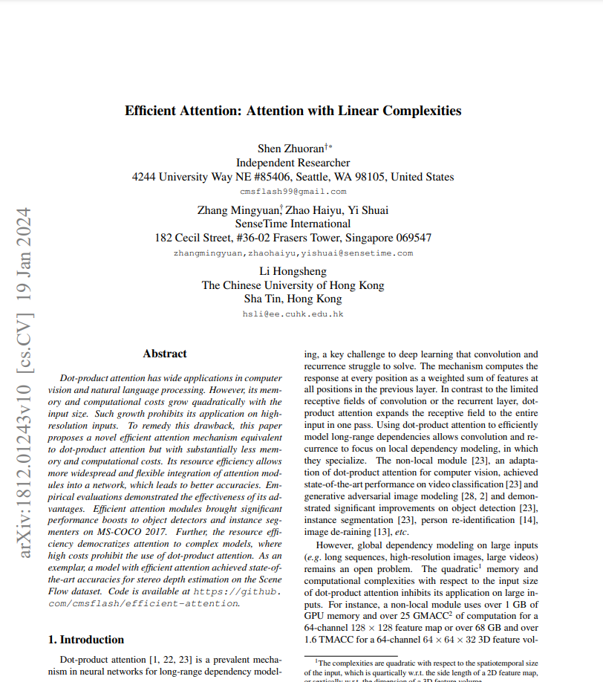
Attention computation is the bottleneck
Quadratic complexity in number of tokens T (a.k.a. context window in text transformers)
lots of work on efficient implementation and simplifying

Slide 12
Notable transformers and their use
Model | Use | Type
The original transformer A. Vaswani, et al. 2017 | language translation | encoder/decoder
BERT J. Devlin, et al. 2018 | text embedding sentiment analysis search spam detector | encoder-only
GPT OpenAI 2017-… | chatbot, etc. | auto-regressive decoder-only
Llama Meta 2023 | chatbot, etc. | open source, auto-regressive decoder-only
ViT A. Dosovitsky, et al. 2020 | image classification | decoder-only or as an encoder in image-to-text models
DiT W. Peebles, et al. 2023 | image generation | transformer and diffusion model have a baby

Slide 13
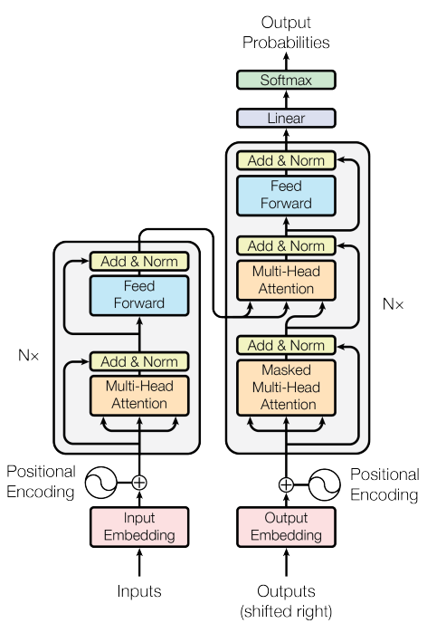
The original transformer
3. next translated word out
Language translation
2. partially translated sentence + empty token in
1. sentence to be translate in

Slide 14
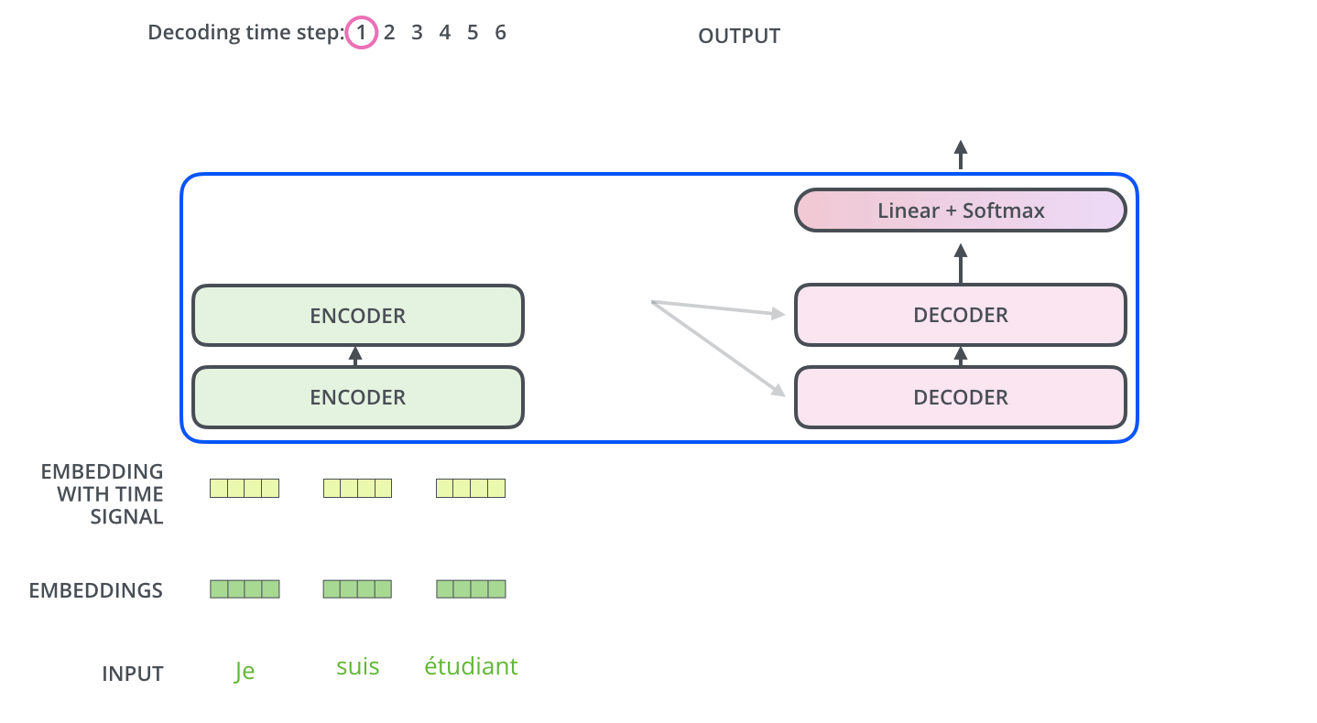
The original transformer
J. Alammar (2018) https://jalammar.github.io/illustrated-transformer/

Slide 15
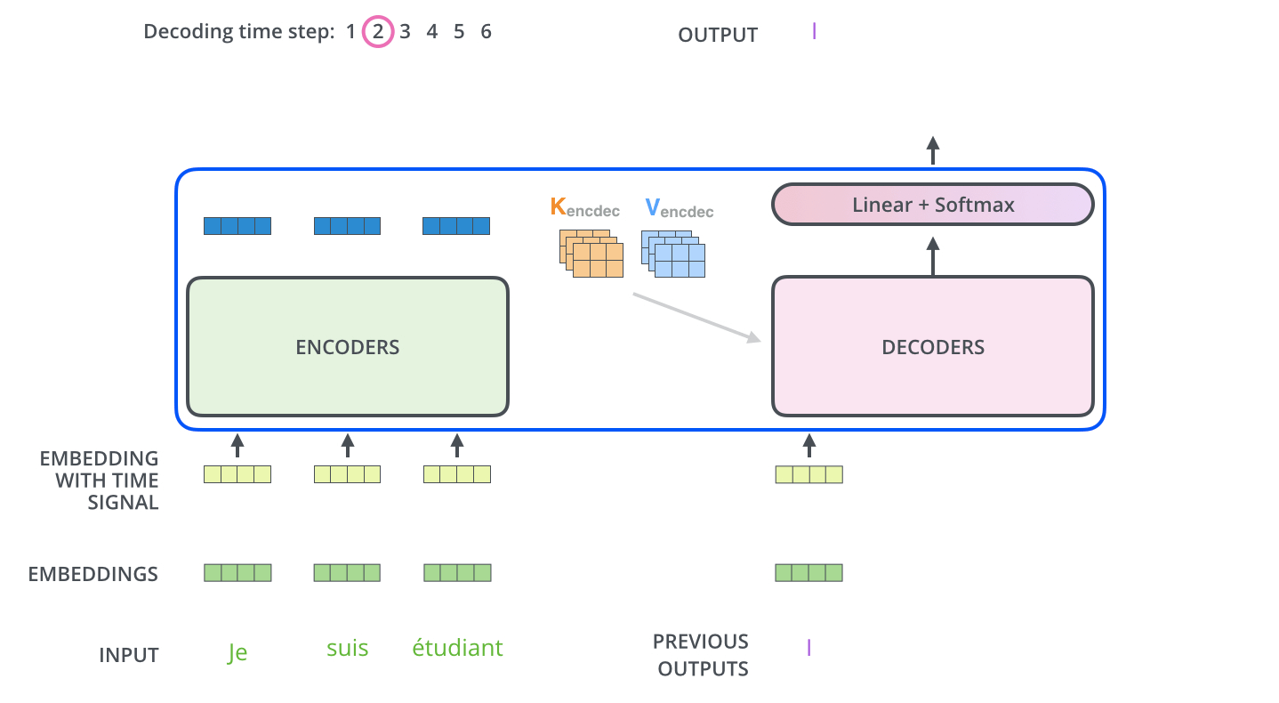
The original transformer
J. Alammar (2018) https://jalammar.github.io/illustrated-transformer/

Slide 16
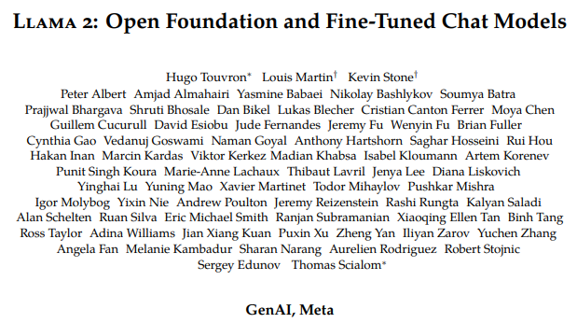
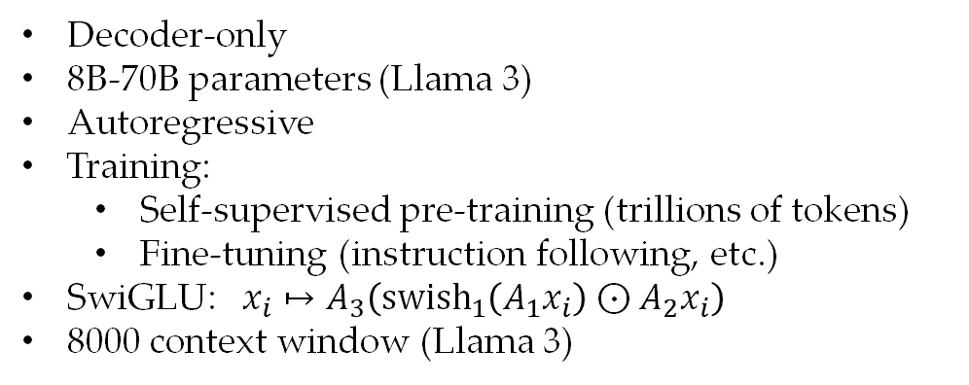
Llama (and relatives)
Decoder-only
8B-70B parameters (Llama 3)
Autoregressive
Training:
  Self-supervised pre-training (trillions of tokens)
  Fine-tuning (instruction following, etc.)
SwiGLU: $x_{i}↦A_{3}\left({\text{swish}}_{1}\left(A_{1}x_{i}\right)⊙A_{2}x_{i}\right)$
8000 context window (Llama 3)

Slide 17
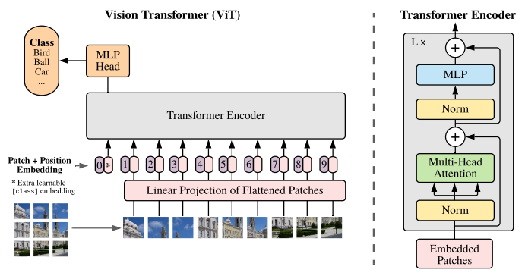
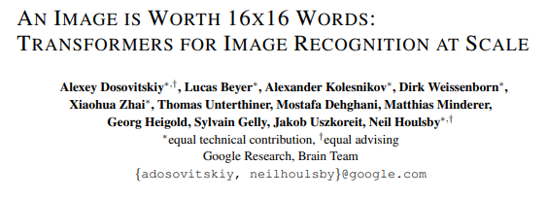
ViT

Slide 18
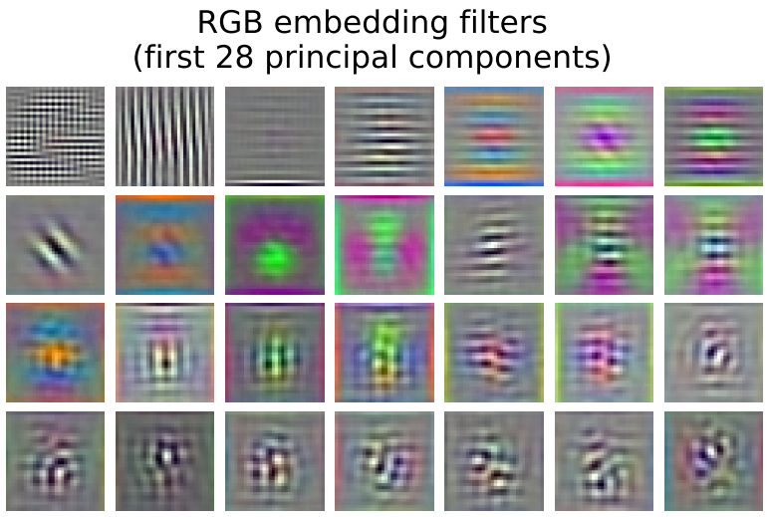
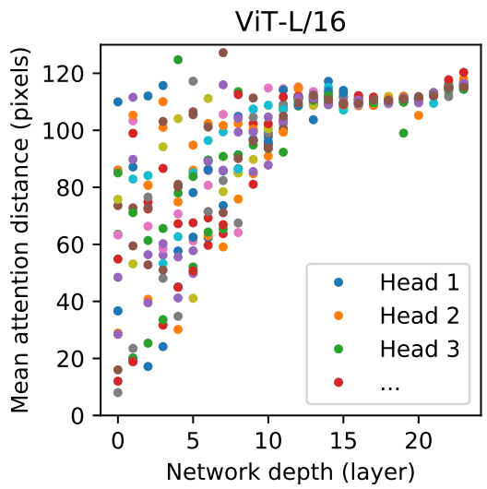
ViT vs. CNN
CNN receptive field
i.e. maximum attention distance
7x7
5x5
3x3

Slide 19
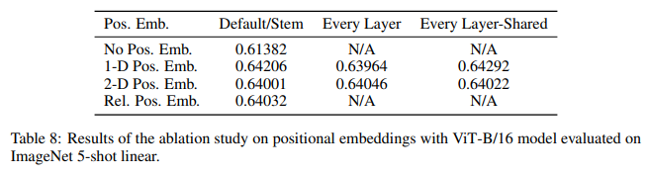
ViT: Geometry is optional 😧

Slide 20
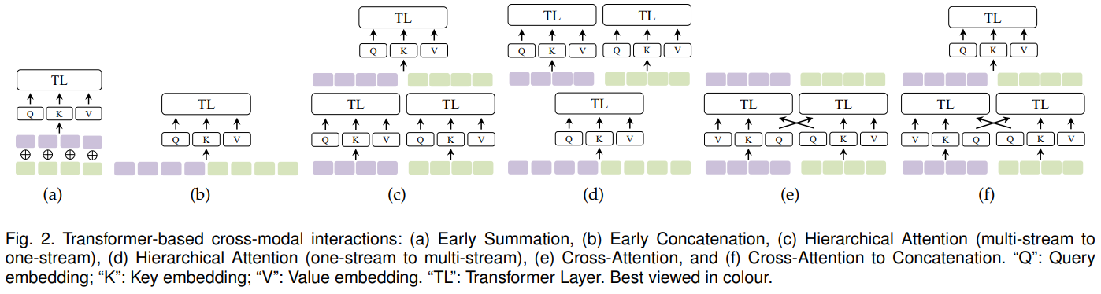
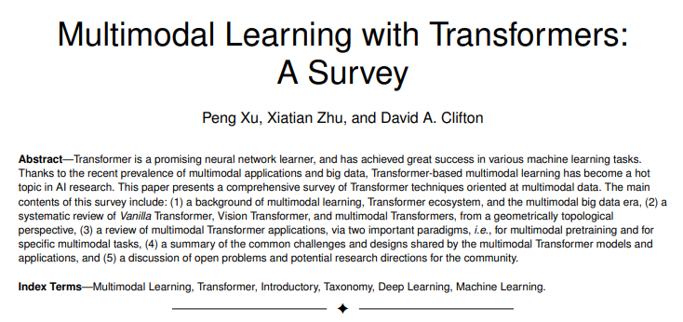
Multimodality

Slide 21
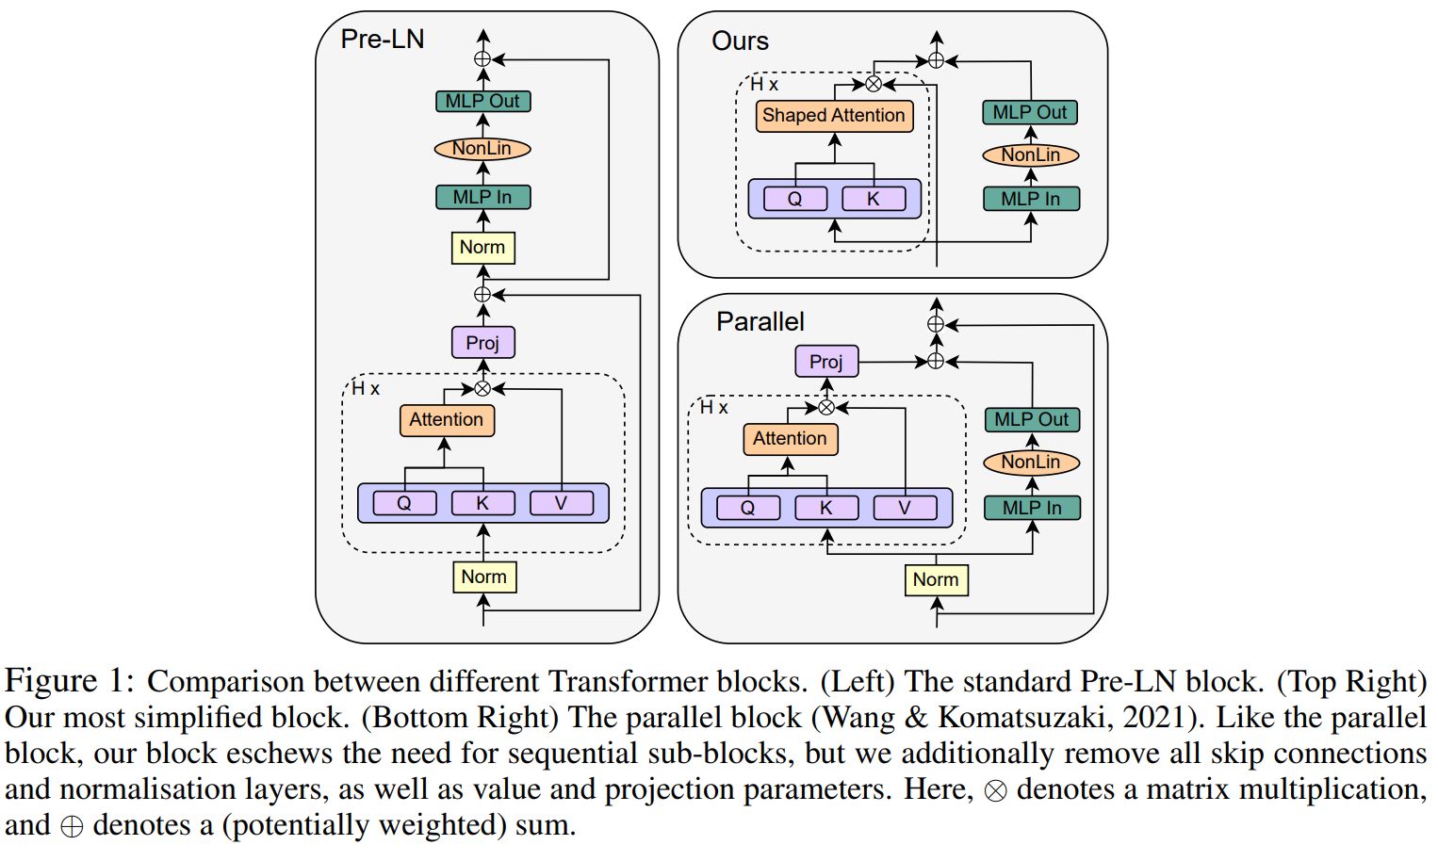
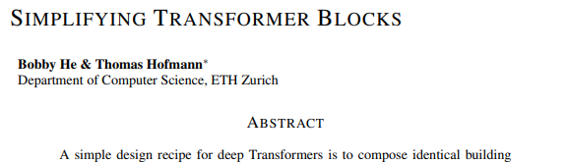
Simplifying

