Slide 1
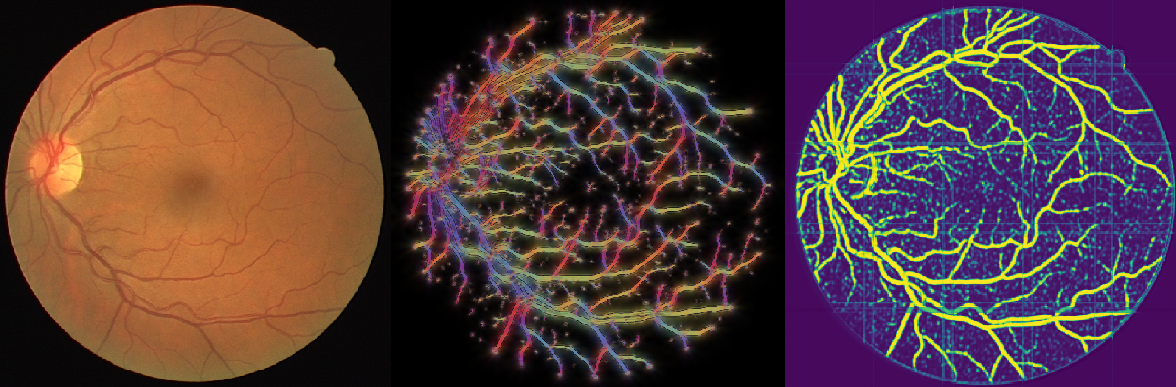
Geometric Image Denoising and Machine Learning
Master Thesis 2019
B.M.N. Smets
Department of Mathematics and Computer Science

Slide 2
Contents
  Introduction
  Denoising
  Machine Learning

Slide 3
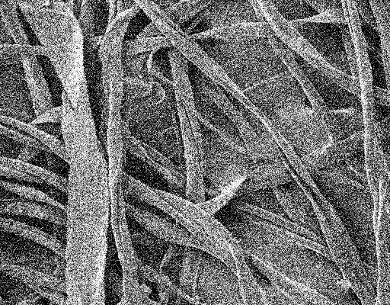
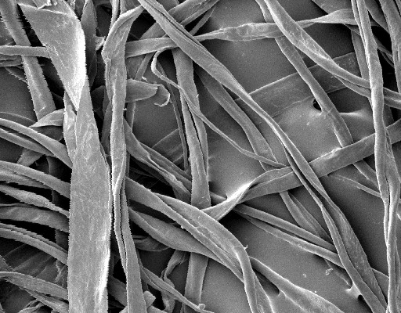
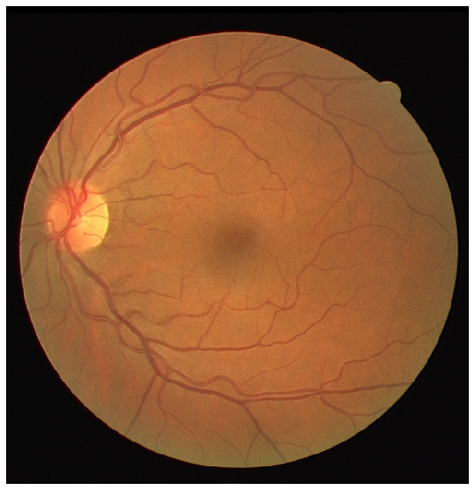
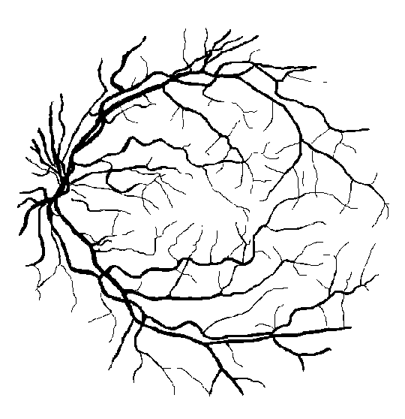
Applications
What we have
What we want
Image denoising
    With PDEs
Segmentation (DRIVE)
    With CNNs

Slide 4
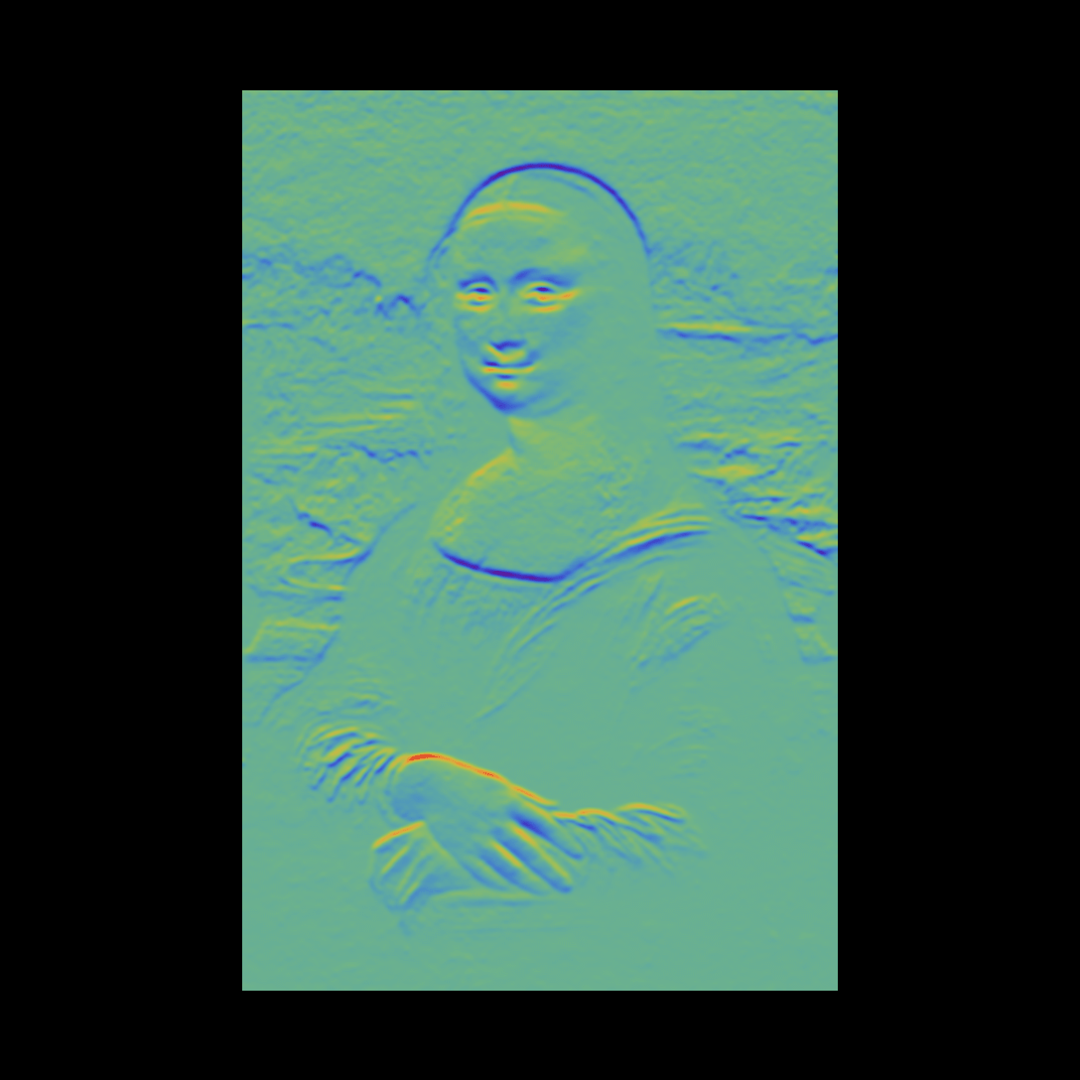
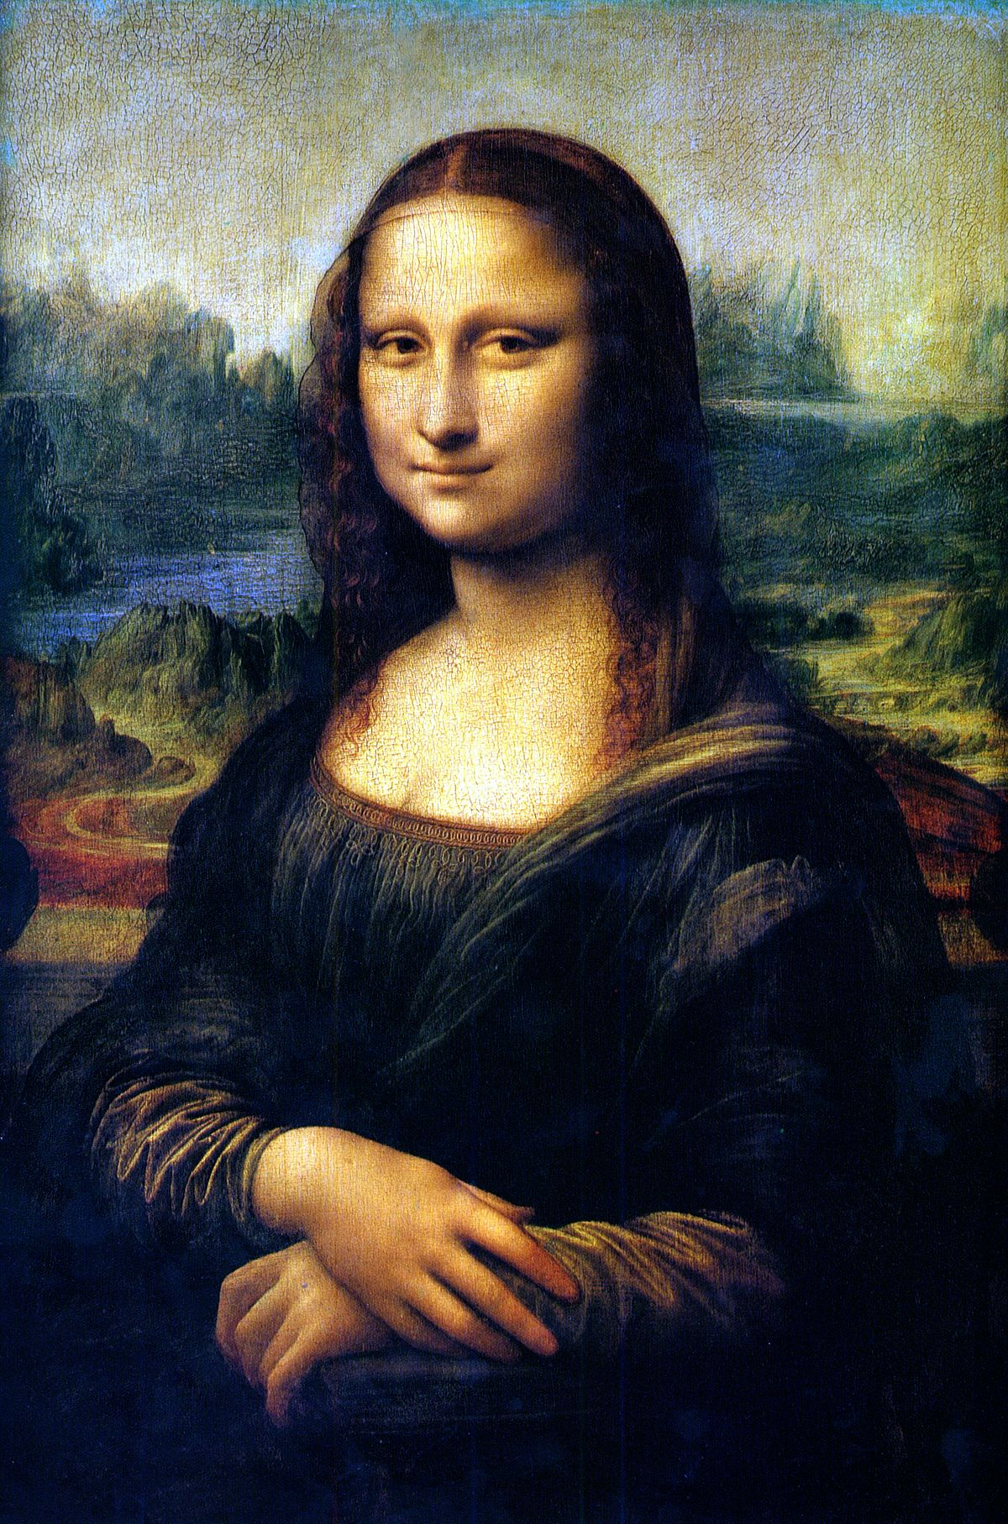
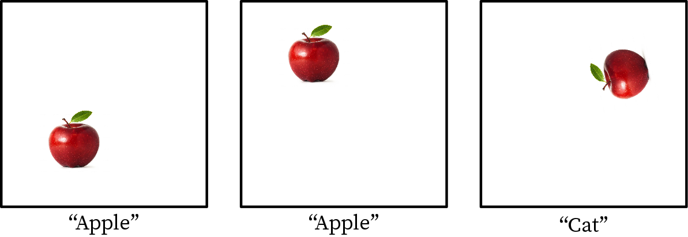
Roto-translation Equivariance
Desirable property for image processing
Classification
Notes:
Invariance in the case of classification,
Caveat: discritazition

Slide 5
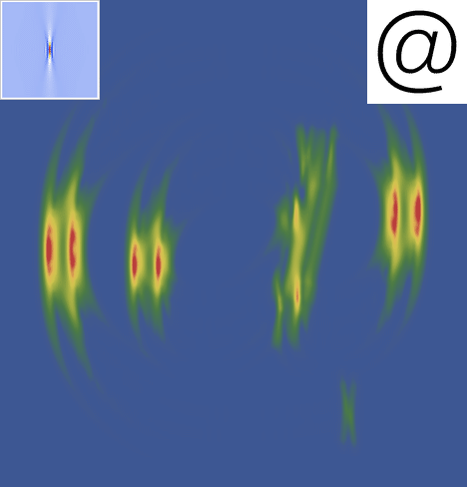
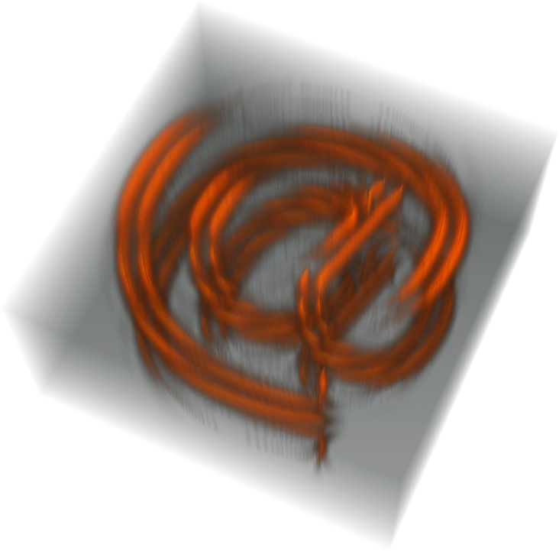
Orientation Score
Decompose image per orientation by convolving with directional filter

Slide 6
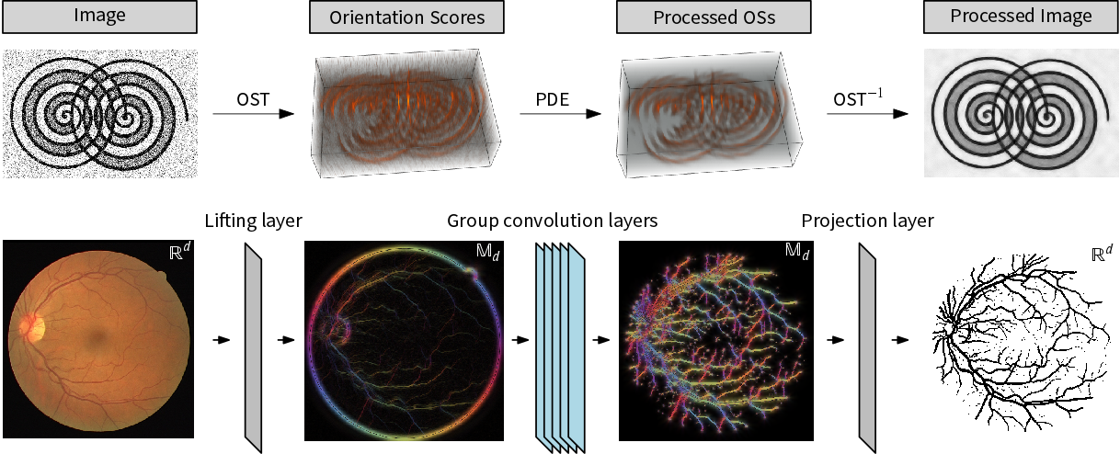
Processing pipeline
Same steps, same geometric theory, different approach

Slide 7
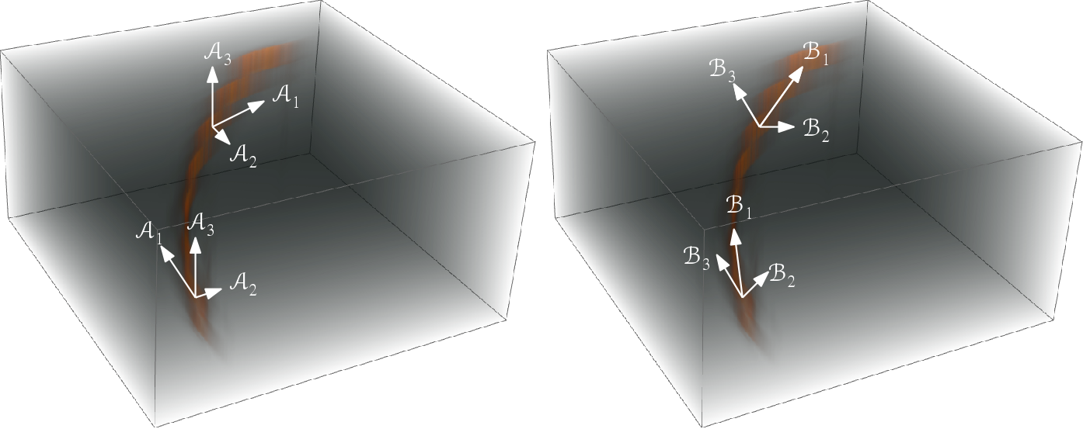
Automatic Roto-translation Equivariance
Make it part of the geometry
Left invariant
Data adaptive (gauge)

Slide 8
Image Denoising
Two geometries
    Left invariant
    Gauge
Three methods
    Diffusion
    Mean Curvature Flow
    Total Variation Flow
Coherence enhancement
= 12 variants
Notes:
12 variants not including choice of parameters

Slide 9
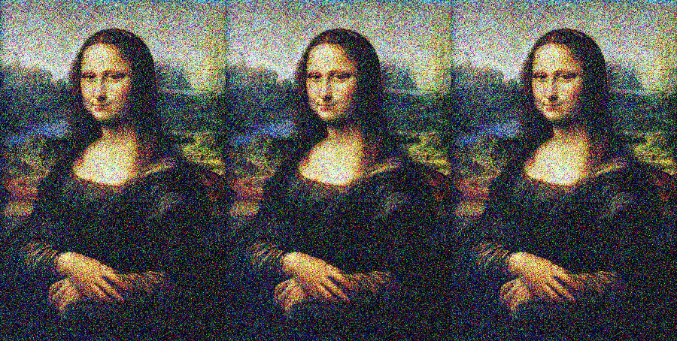



Geometric Flows
Diffusion
Mean Curvature Flow
Total Variation Flow
$$div\left(\frac{∇f}{\left\|∇f\right\|}\right)$$
$$div\left(∇f\right)$$
$\left\|∇f\right\| div\left(\frac{∇f}{\left\|∇f\right\|}\right)$

Slide 10
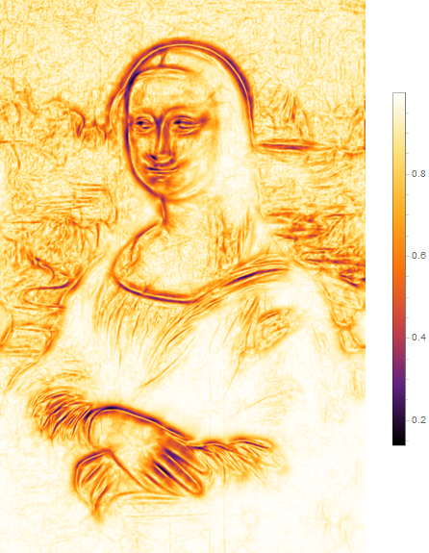
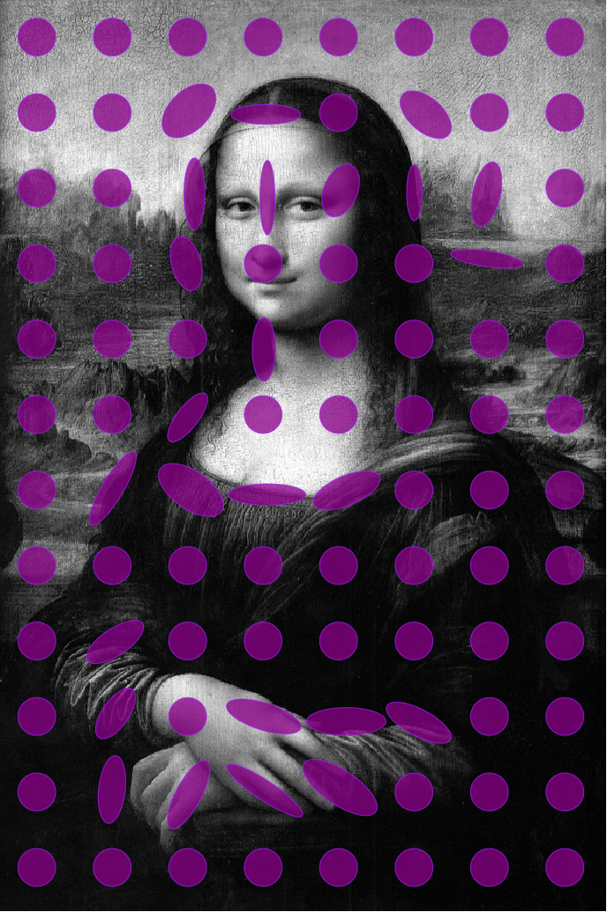
Coherence Enhancement
1) Quantify local isotropy 2) Use that to steer flow

Slide 11

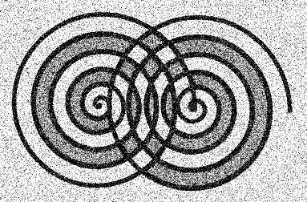
Experiments
On test image
With coherence enhancement

Slide 12

Quantitative Comparison
With Coherence Enhancement
$$\frac{{\left\|f_{t}−f_{source}\right\|}_{L^{p}}}{{\left\|f_{source}\right\|}_{L^{p}}}$$

Slide 13
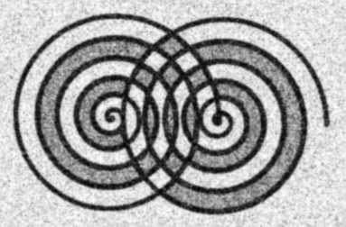

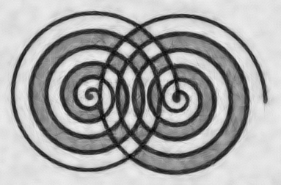


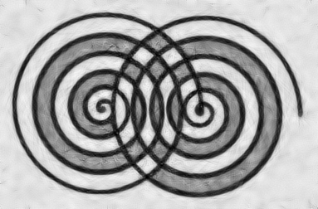
Qualitative Comparison
2x minimal L2 error time
 | Diffusion | Mean Curvature Flow | Total Variation Flow
Left Invariant
Gauge

Slide 14
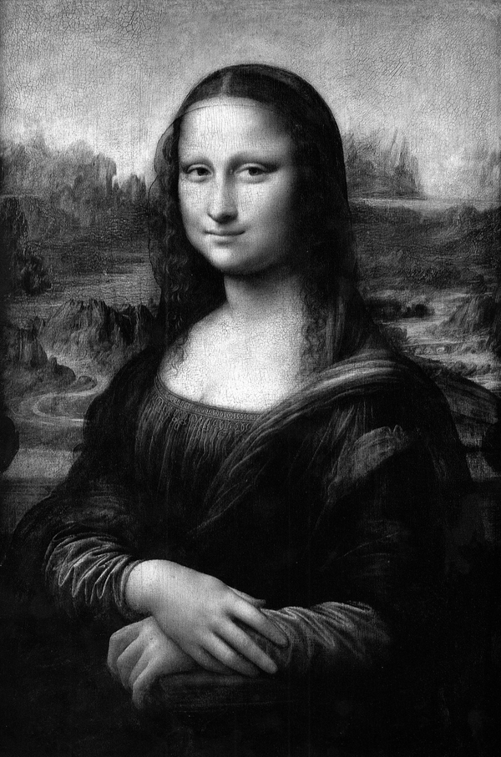
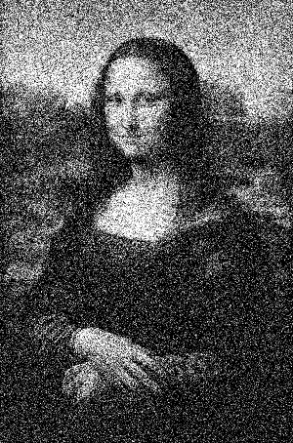

Picking the best parts
3-stage TVF
Initial smoothing using left invariant TVF without CE
Fit gauge frames and smooth using gauge TVF with CE
Rescale post-processing
Notes:
Conservative fixed time for step 1.

Slide 15
Quantitative Comparison
3-stage TVF
$$\frac{{\left\|f_{t}−f_{source}\right\|}_{L^{p}}}{{\left\|f_{source}\right\|}_{L^{p}}}$$

Slide 16
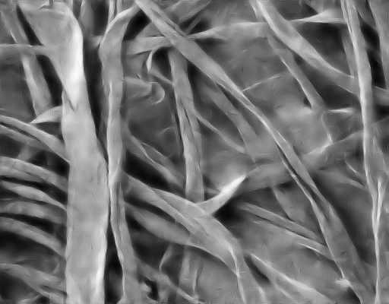
Qualitative Comparison
3-stage TVF

Slide 17
Machine Learning
Application: segmentation/classification
Spatial Convolutional Neural Networks
Group Convolutional Neural Networks
    Lifting layer
    Group convolution layer
    Projection layer
PDE guided CNN design

Slide 18
Application: DRIVE Segmentation
What we have
What we want
Notes:
Segmentation vs. classification
Equivariance due to data-augmentation

Slide 19
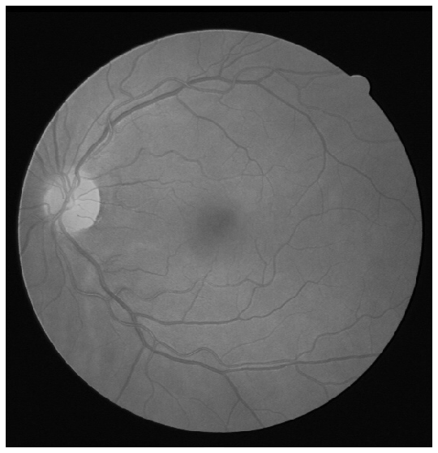
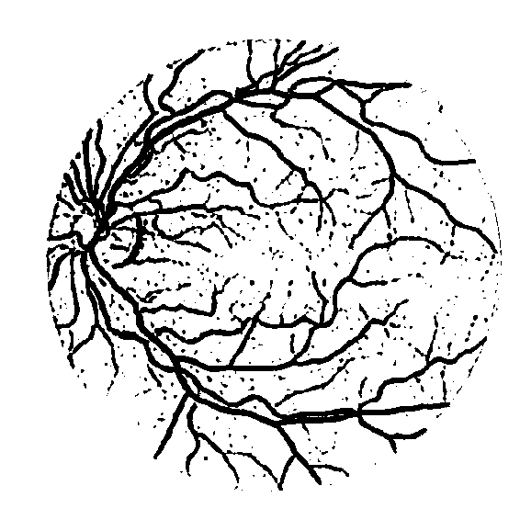

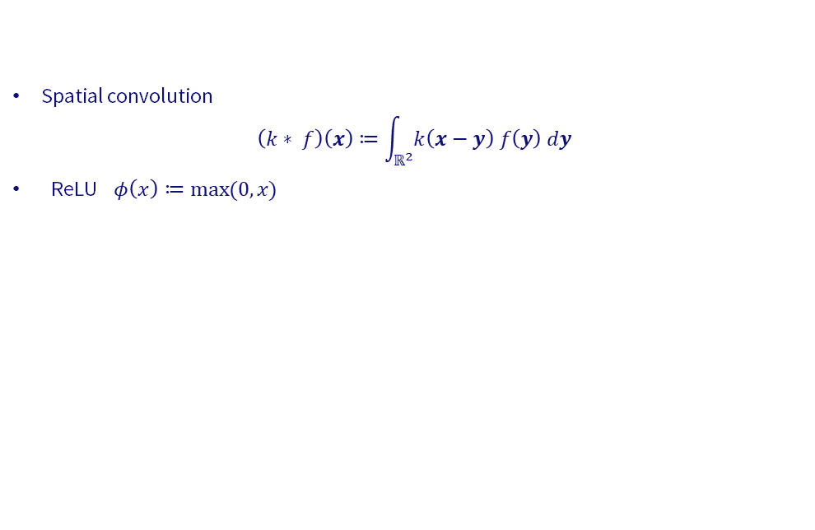

Spatial Segmentation CNN
Spatial convolution
$$\left(k∗_{ }f\right)\left(x\right)≔\int_{ℝ^{2}}^{ }{k\left(x−y\right) f\left(y\right) dy}$$
ReLU $φ\left(x\right)≔max⁡(0,x)$
$$⋯$$
$$argmax$$

Slide 20

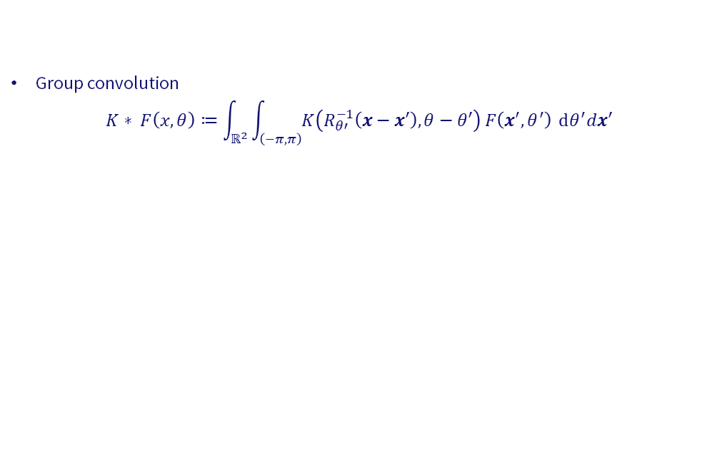
$𝕄_{2}$ Segmentation CNN
Group convolution
$$K∗_{ }F\left(x,θ\right)≔\int_{ℝ^{2}}^{ }{\int_{\left(−π,π\right)}^{ }{K\left(R_{θ′}^{−1}\left(x−x′\right), θ−θ′\right) F\left(x^{′}, θ^{′}\right)}} dθ^{′}dx′$$
$$⋯$$
$$argmax$$
Lift
Project

Slide 21
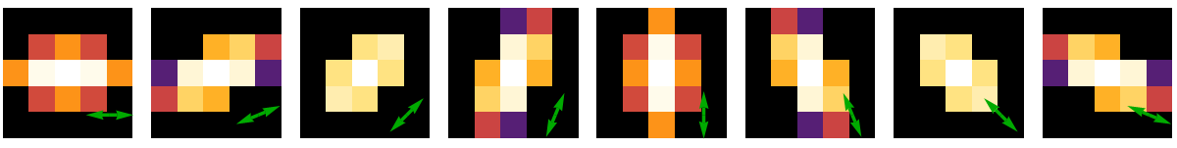
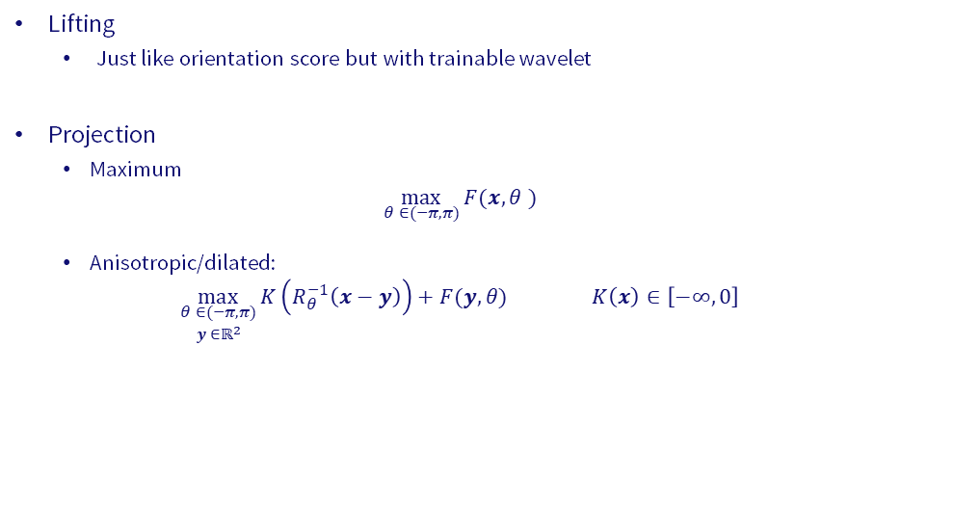
$𝕄_{2}$ Segmentation CNN
Lifting
      Just like orientation score but with trainable wavelet
Projection
      Maximum
      $$\max_{θ^{ }∈(−π,π)}{F(x, θ^{ })}$$
      Anisotropic/dilated:
      $$\max_{\begin{matrix}θ^{ }∈(−π,π) \\ y^{ }∈ℝ^{2}\end{matrix}}{K\left(R_{θ}^{−1}\left(x−y\right)\right)+F(y,θ)} K\left(x\right)∈\left[−∞, 0\right]$$
Notes:
Maximum is special case of AP

Slide 22
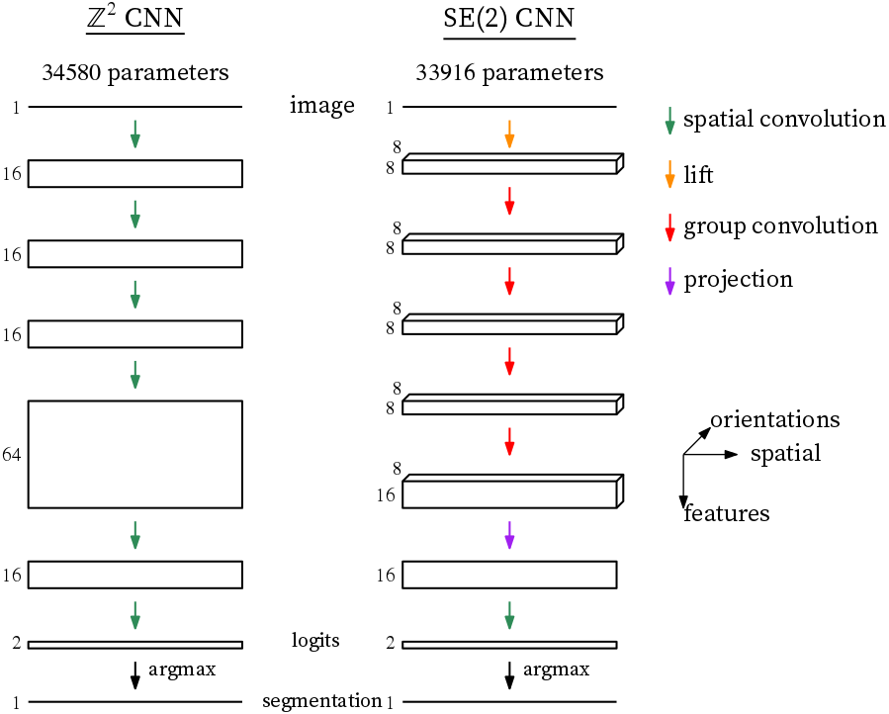
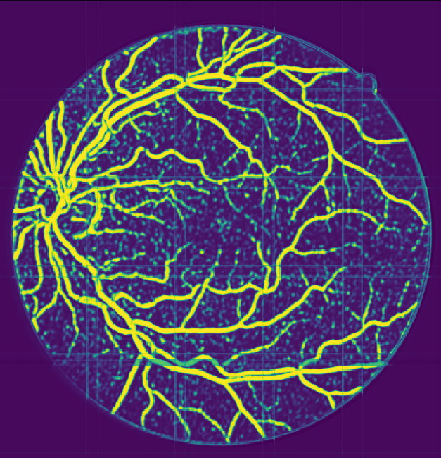
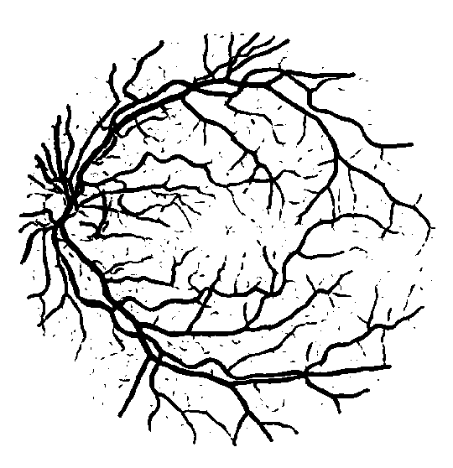
Experiments

Slide 23
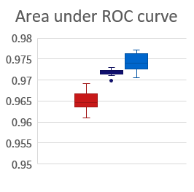
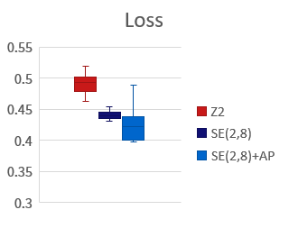
Performance comparison

Slide 24
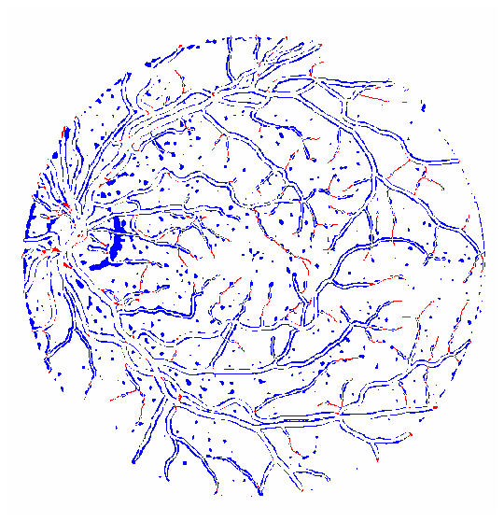
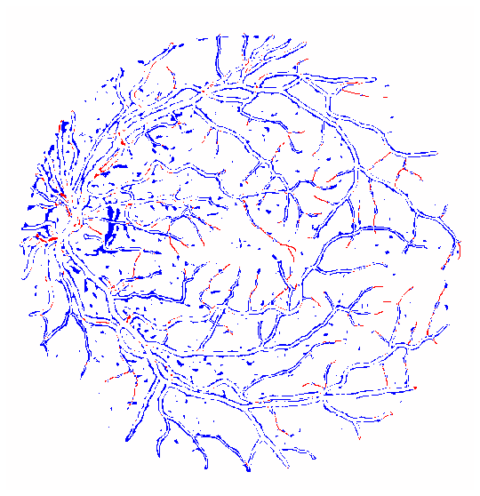
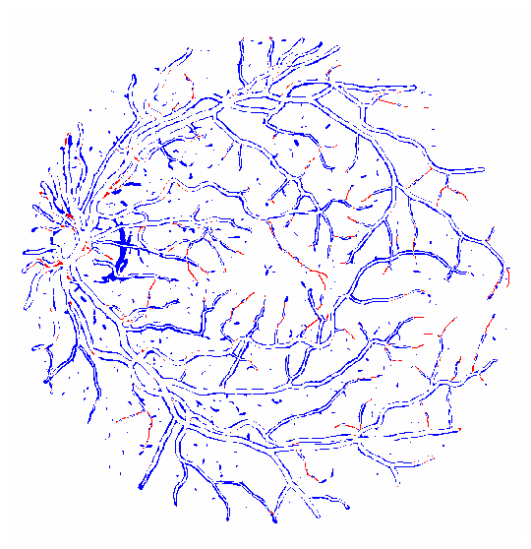

Machine vs. human
$$ℤ^{2}$$
SE(2,8)
SE(2,8)+AP

Slide 25
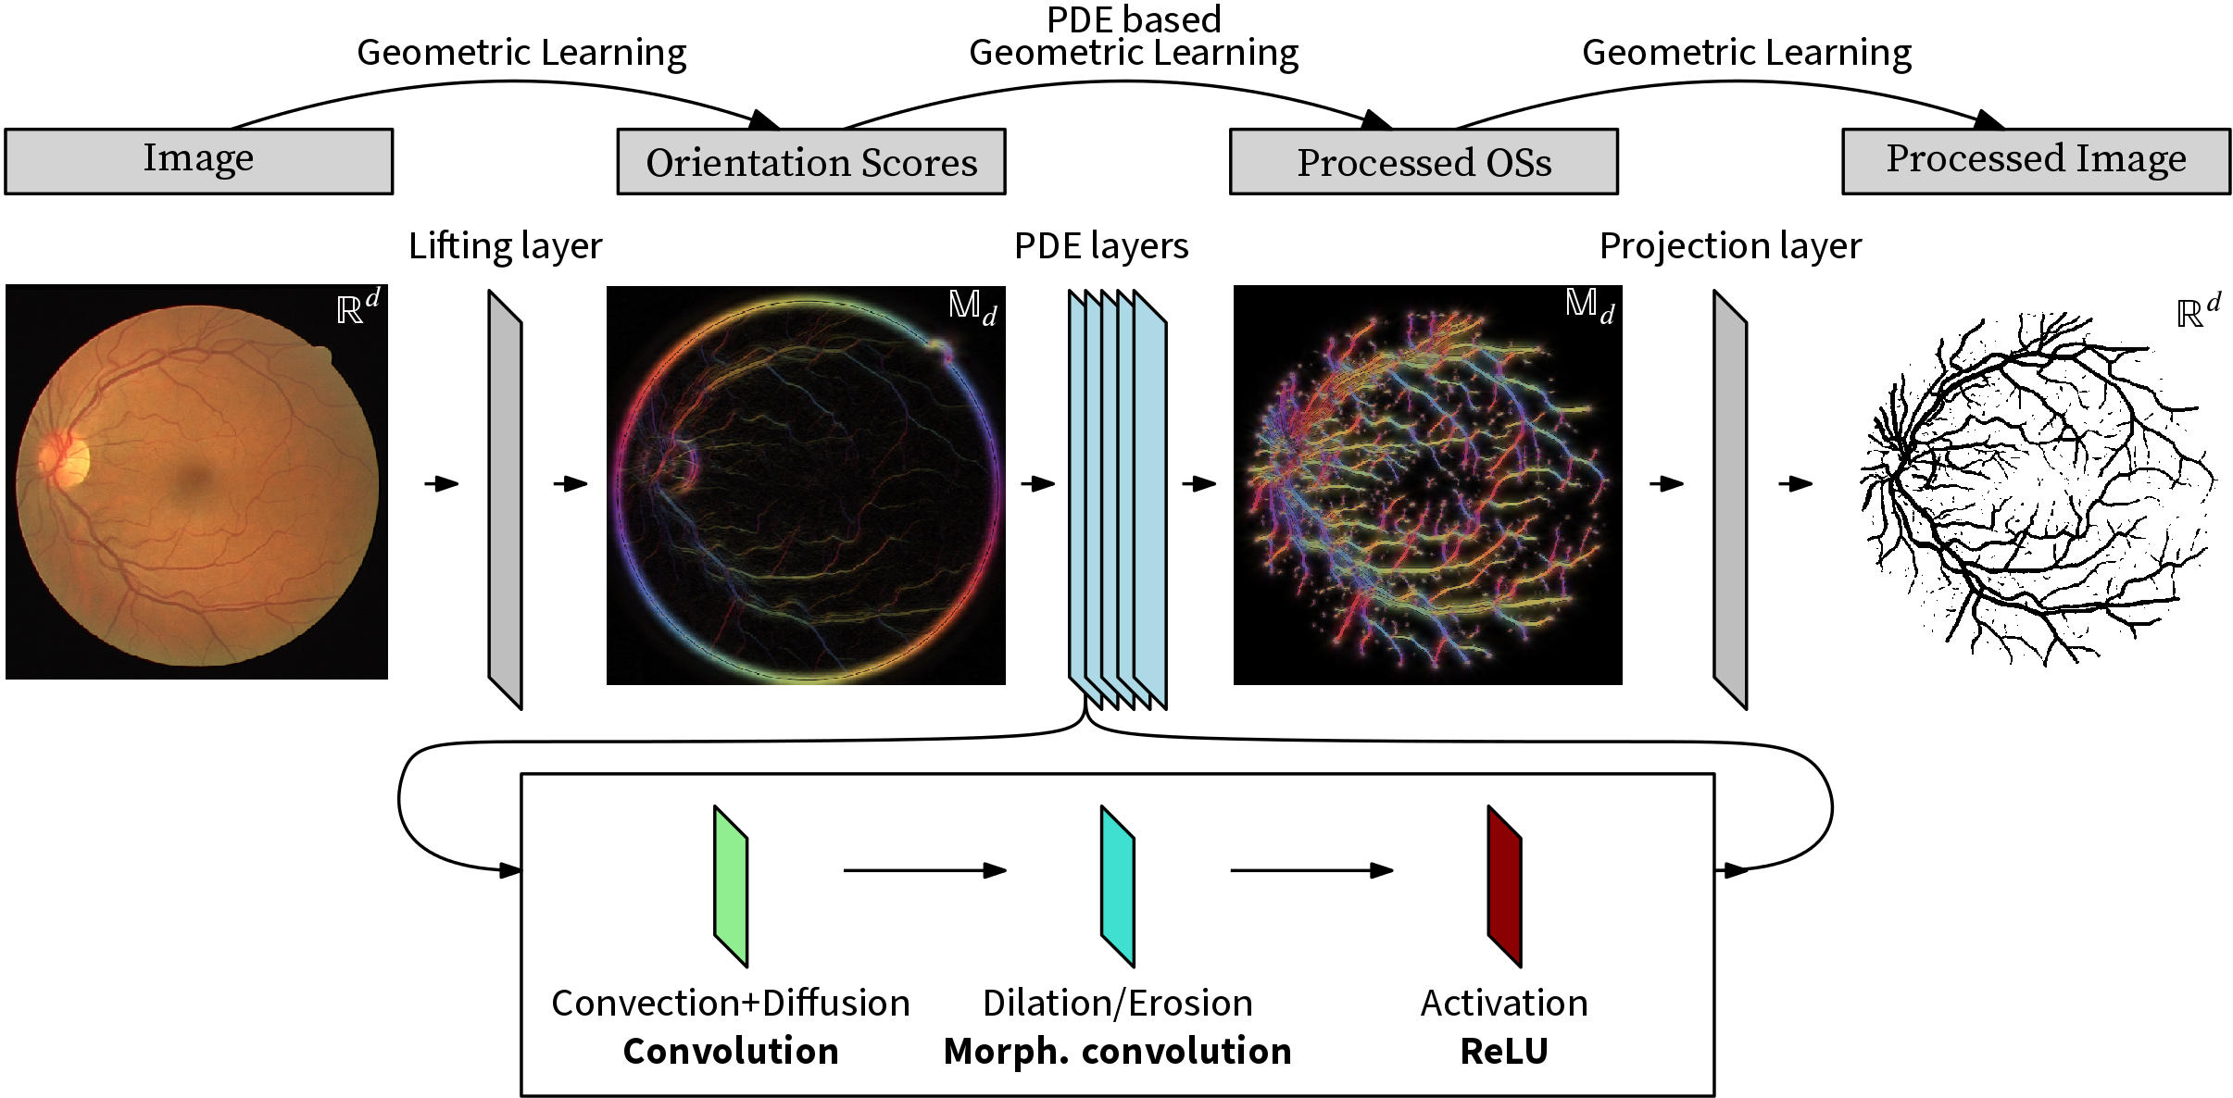

PDE Guided CNN Design
$$\frac{∂W}{∂t}=−c⋅∇_{G_{1}}W+{\left|Δ_{G_{2}}\right|}^{α}W±{\left\|∇_{G_{3}}W\right\|}^{2α}$$

Slide 26
Thank you

