Slide 1
PDE-based CNNs with Morphological Convolutions
B.M.N. Smets
Department of Mathematics and Computer Science
Notes:
Link CNNs to PDEs
Geometric interpretability
Add/modify/remove from CNNs based on PDE insights

Slide 2
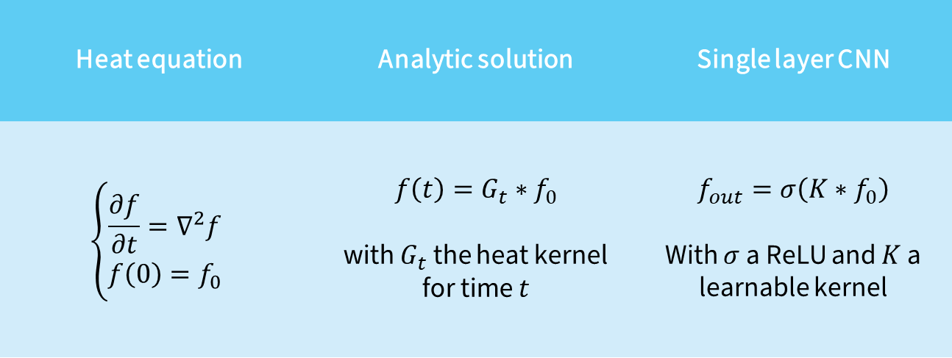


Basic Example
Modeling a heat process by a single layer CNN
Heat equation | Analytic solution | Single layer CNN
$$\left\{\begin{aligned}\frac{∂f}{∂t}=∇^{2}f \\ f\left(0\right)=f_{0}\end{aligned}\right.$$ | $$f\left(t\right)=G_{t}∗f_{0}$$ with $G_{t}$ the heat kernel for time $t$ | $$f_{out}=σ\left(K∗f_{0}\right)$$ With $σ$ a ReLU and $K$ a learnable kernel
$$≡$$
$$≡$$
Notes:
Quod rotation equivariance?
Simple example, link not as simple in general

Slide 3


Equivariance
Group CNNs
“Apple”
“Apple”
“Dog”
“Boat”
 | Translation | Rotation | Scaling
Spatial CNN
SE(d) CNN
SIM(d) CNN
Notes:
Approach can easily be extended to other symmetry groups like SIM(d)

Slide 4

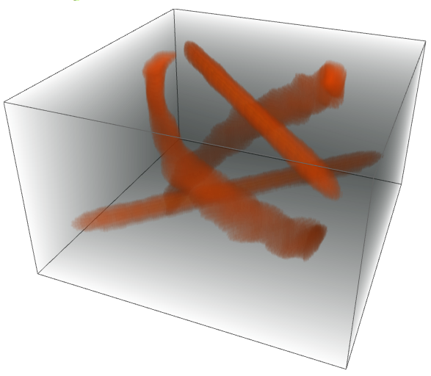



Extending the domain
To a homogeneous space of the symmetry group
Lift
$$θ$$
Project
$$y$$
$$x$$
Orientation Score Transform
Can be learned
More straightforward to design roto-translation equivariant CNNs

Slide 5
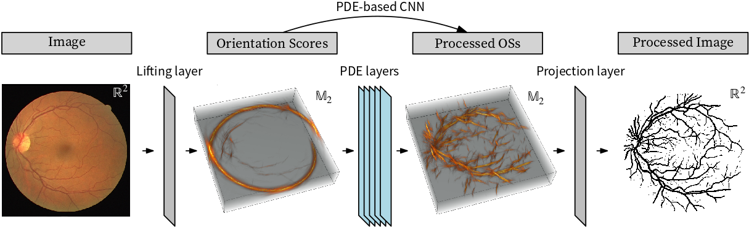











PDE-based CNN
An example segmentation network
$$∗$$
Previous
$$∗$$
$$∗$$
$$□$$
$$σ$$
$$A$$
$$⋮$$
$$⋮$$
Next
$$⋮$$
$$⋮$$
$$⋮$$
$$∗$$

Slide 6










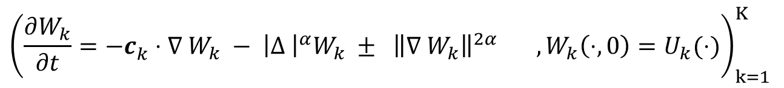
PDE Layer
$${\left(\frac{∂W_{k}}{∂t}=−c_{k}^{ }⋅∇_{ }W_{k} − {\left|Δ_{ }\right|}^{α}W_{k} ± {\left\|∇_{ }W_{k}\right\|}^{2α} , W_{k}\left(⋅, 0\right)=U_{k}(⋅)\right)}_{k=1}^{K}$$
Goal | Transport | Regularization | Max pooling | Normalization | Combination
PDE | Convection | Fractional diffusion | Dilation Erosion | Codomain transformation | Create initial conditions for next set of PDEs
Numerical operation | Convolution |  | Morph. Convolution | ReLU | Linear combinations
$$∗$$
Previous
$$∗$$
$$∗$$
$$□$$
$$σ$$
$$A$$
$$⋮$$
$$⋮$$
Next
$$⋮$$
$$⋮$$
$$⋮$$
$$∗$$
Initial conditions
Solutions of PDEs after certain time
Initial conditions for next PDEs
Notes:
Alpha?

Slide 7
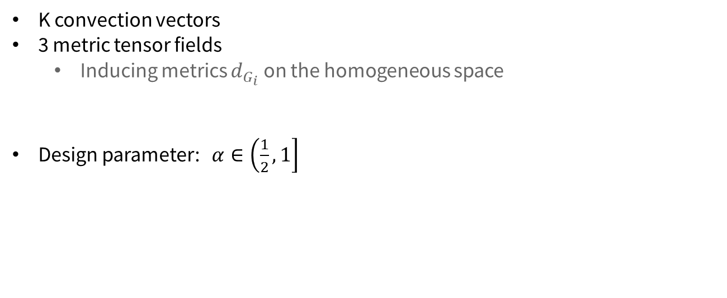
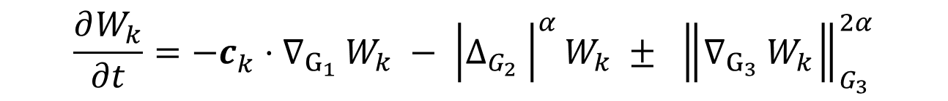
Parameters
What will we be training?
$$\frac{∂W_{k}}{∂t}=−c_{k}^{ }⋅{∇_{G_{1}}}_{ }W_{k} − {\left|{Δ_{G_{2}}}_{ }\right|}^{α}W_{k} ± {\left\|{∇_{G_{3}}}_{ }W_{k}\right\|}_{G_{3}}^{2α}$$
K convection vectors
3 metric tensor fields
  Inducing metrics $d_{G_{i}}$ on the homogeneous space
Design parameter: $α∈\left.\left(\frac{1}{2},1\right.\right]$
Notes:
Terse in my notation on the previous slide

Slide 8

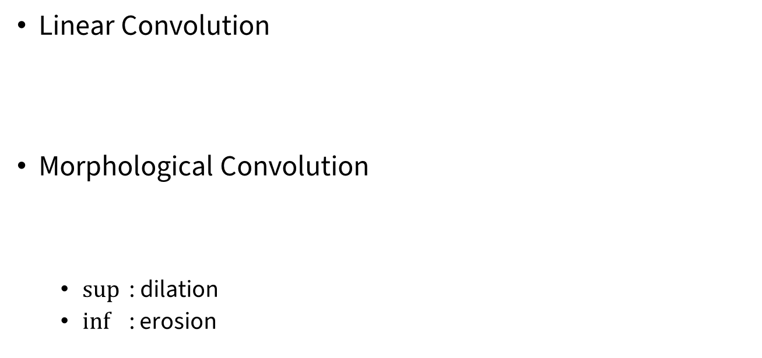


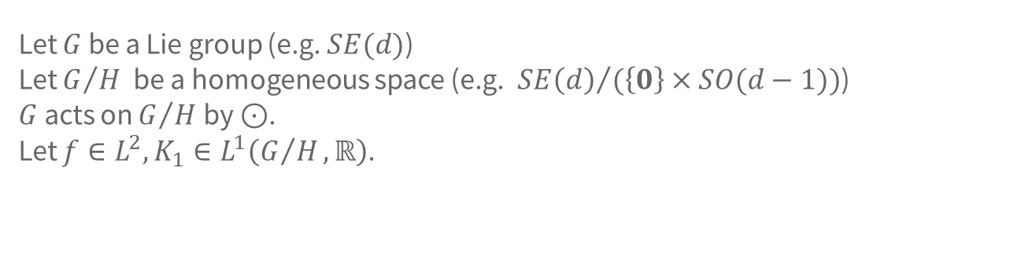

Constructing Solutions
Let $G$ be a Lie group (e.g. $SE(d)$)
Let $G/H$ be a homogeneous space (e.g.${SE\left(d\right)}/{(\left\{0\right\}}×SO(d−1))$)
$G$ acts on $G/H$ by $⊙$.
Let $f∈L^{2},K_{1}∈L^{1}\left(G/H, ℝ\right)$.
Linear Convolution
Morphological Convolution
  $\sup{ }$: dilation
  $\inf{ }$ : erosion
$$∗$$
$$∗$$
$$\left(K_{1}∗f\right)\left(x\right)=\int_{G}{K_{1}\left(h^{−1}⊙x\right) f\left(h⊙e\right) dμ(h)}$$
$$□$$
$$\left(K_{2}□f\right)\left(x\right)=\underset{h∈G}{sup/inf}{ K_{2}\left(h^{−1}⊙x\right)+ f\left(h⊙e\right)}$$
Notes:
K_2 is convex, lower semi-continuous and proper.

Slide 9
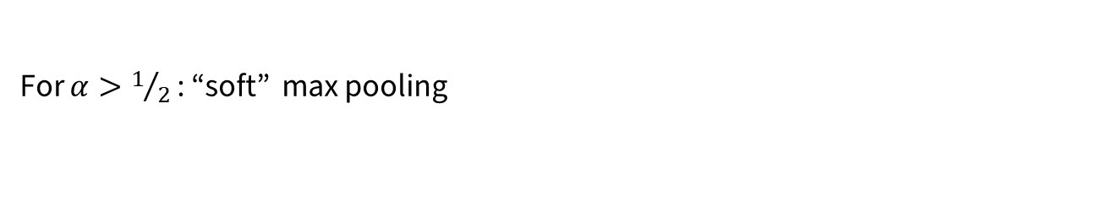
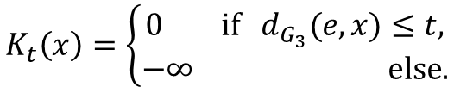

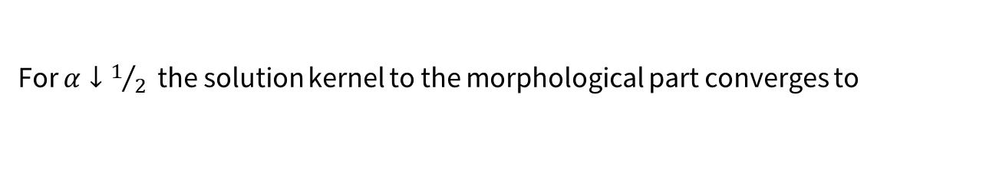
Max Pooling
Morphological Convolution generalizes Max Pooling
For $α↓1/2$ the solution kernel to the morphological part converges to
$$K_{t}\left(x\right)=\left\{\begin{aligned}0 \text{if} d_{G_{3}}(e,x)≤t, \\ −∞ \text{else}.\end{aligned}\right.$$
$$\left(K_{t}□f\right)\left(x\right)= \sup_{h∈G}{K\left(h^{−1}⊙x\right)+ f\left(h⊙e\right)}$$
$$= \sup_{ }\left\{f\left(h⊙e\right) | h∈G :d_{G_{3}}\left(e, h^{−1}⊙x\right)≤t\right\}$$
$$= \sup_{ }\left\{f\left(h⊙e\right) | h∈G :d_{G_{3}}\left(h⊙e, x\right)≤t\right\}$$
$$=\sup_{y∈B(x,t)}{f(y)}$$
For $α>1/2$ : “soft” max pooling

Slide 10
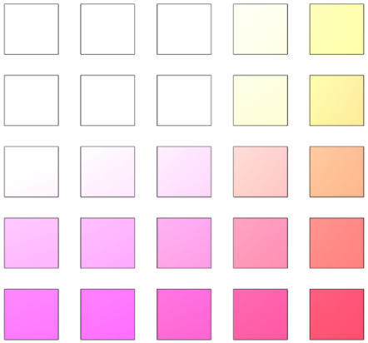
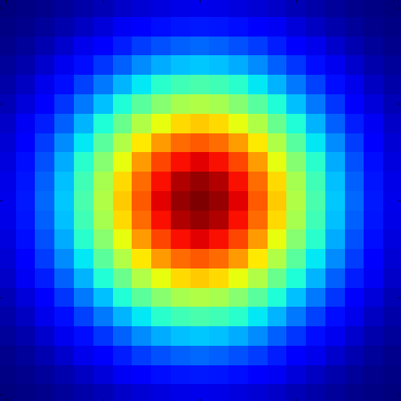



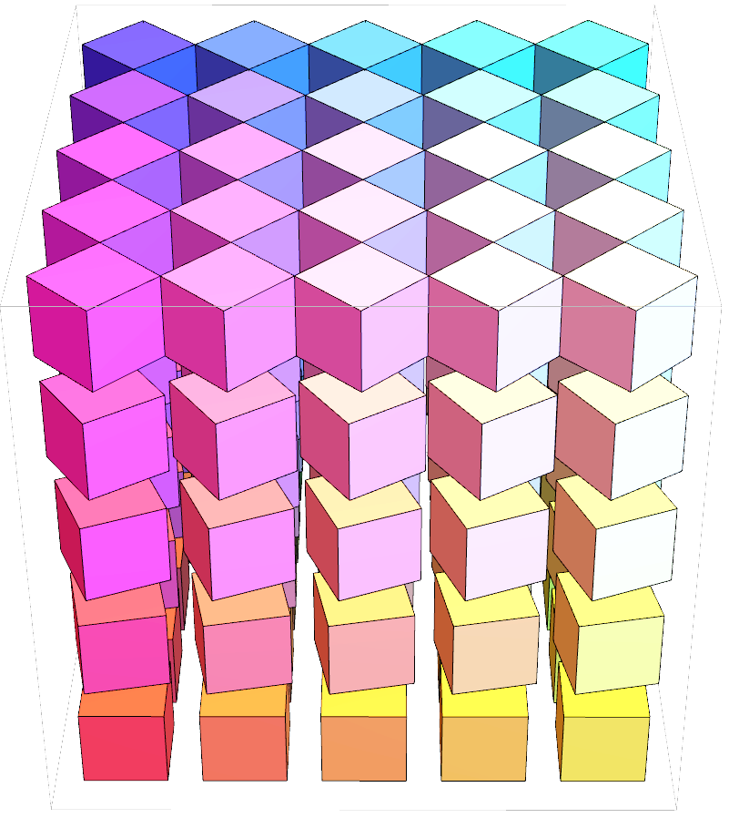
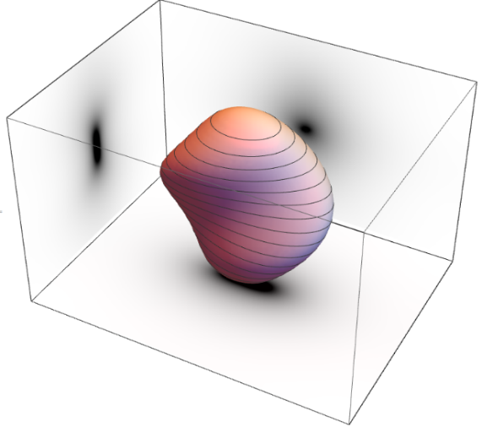

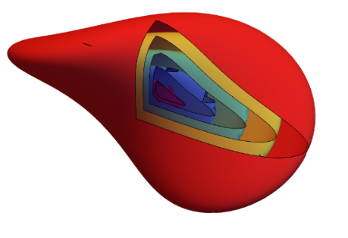


Geometric Interpretation
Transport
Regularization
Max Pooling
$$\frac{∂W_{k}}{∂t}= −c_{k}^{ }⋅{∇_{G_{1}}}_{ }W_{k} − {\left|{Δ_{G_{2}}}_{ }\right|}^{α}W_{k} ± {\left\|{∇_{G_{3}}}_{ }W_{k}\right\|}_{G_{3}}^{2α}$$

Slide 11

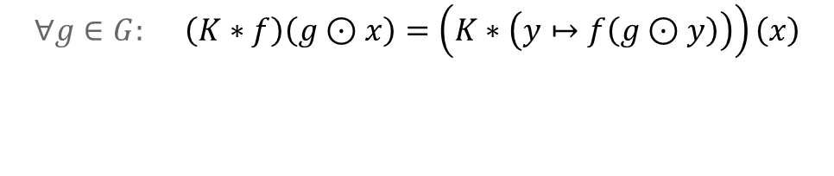
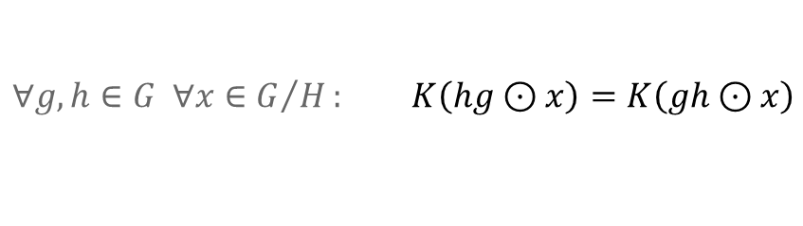
Maintaining Equivariance
Conditions on the kernels?
Linear convolution
Same for morphological convolution
Kernel symmetries are required!
$$∀g∈G: \left(K∗f\right)\left(g⊙x\right)=\left(K∗\left(y↦f\left(g⊙y\right)\right)\right)\left(x\right)$$
$$⟺$$
$$∀g,h∈G ∀x∈G/H: K\left(hg⊙x\right)=K\left(gh⊙x\right)$$

Slide 12
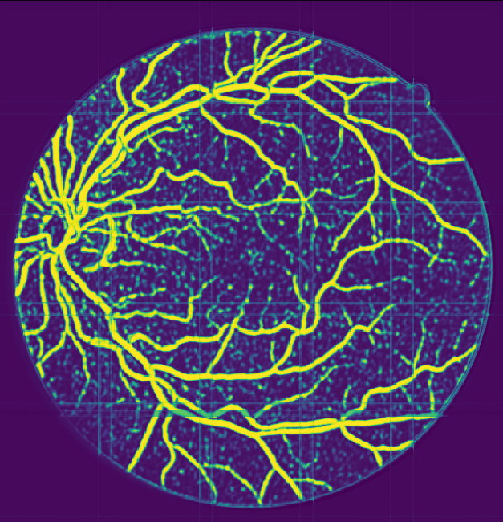
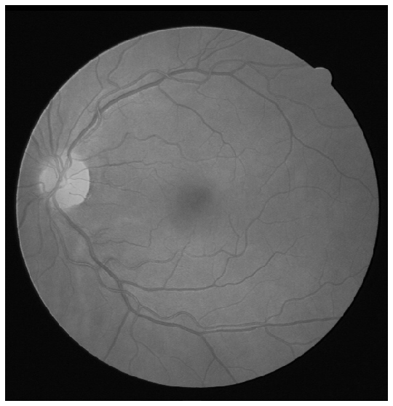
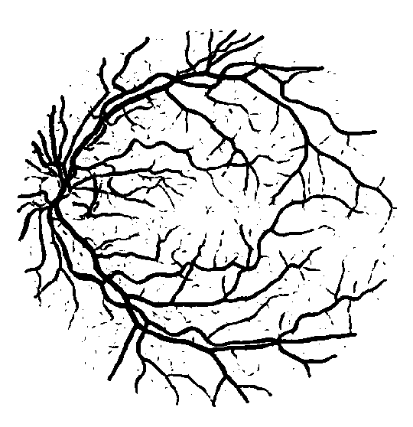
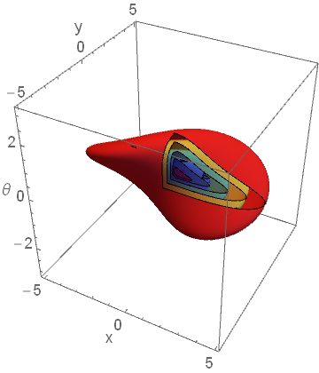
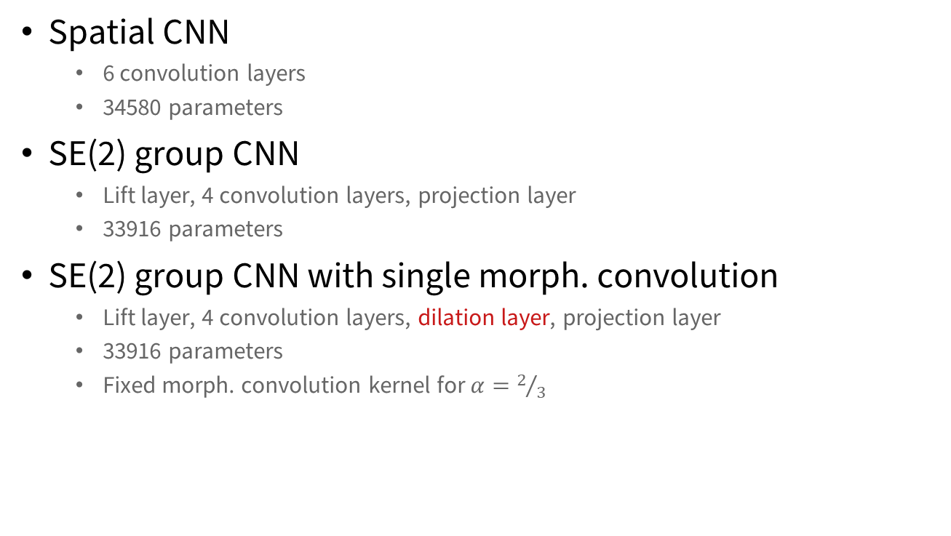
First Experiment
Adding morphological convolution to a retinal segmentation network
Spatial CNN
  6 convolution layers
  34580 parameters
SE(2) group CNN
  Lift layer, 4 convolution layers, projection layer
  33916 parameters
SE(2) group CNN with single morph. convolution
  Lift layer, 4 convolution layers, dilation layer, projection layer
  33916 parameters
  Fixed morph. convolution kernel for $α=2/3$

Slide 13
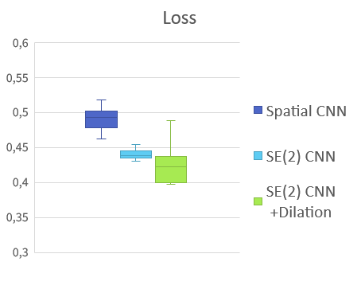
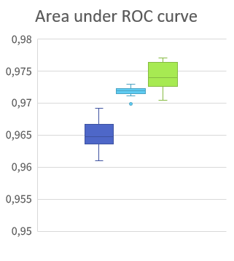
First Experiment
Performance improvement
Notes:
Same number of epochs.
But dilation slows training.

Slide 14

Current and Future Work
$$∗$$
$$∗$$
$$∗$$
$$□$$
$$σ$$
$$A$$
$$∗$$
$$⋮$$
$$⋮$$
$$⋮$$
$$⋮$$
TensorFlow implementation
  experiments
Layer architectures
Geometric interpretability
Probabilistic interpretability
Integrate PDE framework for geometric equivariant processing of orientation scores (2005-now)
$$∗$$
$$∗$$
$$□$$
$$∗$$
$$⋮$$
$$∗$$
$$⋮$$
$$□$$
$$σ$$
$$A$$
$$∗$$
$$∗$$
$$□$$
$$⋮$$
$$⋮$$
$$∗$$
$$∗$$
$$∗$$
$$□$$
$$σ_{1}$$
$$A$$
$$∗$$
$$□$$
$$A$$
$$⋮$$
$$∗$$
$$⋮$$
$$⋮$$
$$∗$$
$$□$$
$$σ_{2}$$
$$A$$
$$∗$$
$$∗$$
$$□$$
$$A$$
$$σ_{1}$$
$$⋮$$
$$⋮$$
$$⋮$$
$$σ_{2}$$
$∇ Δ \operatorname{div}{ \left(⋅,⋅\right) \left\|⋅\right\|}$

Slide 15

Concluding remarks
Geometric PDE framework for CNNs
Improved performance over state-of-the-art G-CNNs
  by inclusion of single PDE-based morphological convolution layer
Problem symmetry integral part of the design
Also see 2 talks in IHP Paris search: “Remco Duits IHP”
Deep
Learning
Inspire
Mathematics
Improve

